Slide 1



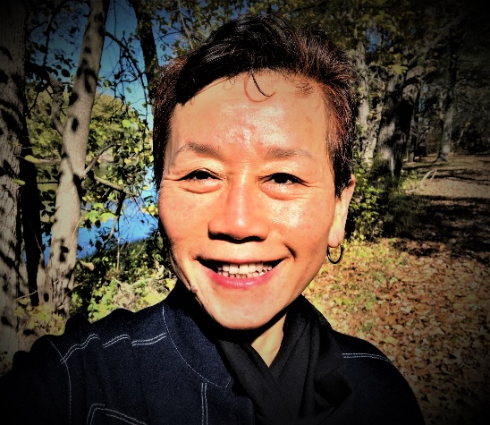
Hunyuan Qigong
Harmonizing body and heart
Dr. Mei Wang
November 11, 2021, at 12:25 P.M. Fulcrum Symposium
Virtual Room
Professor at Northwestern Health Sciences University

Slide 2

Important Terminologies & Concepts
Qi
Yin & Yang
Dantian
3 burners
Wuji posture

Slide 3
Special Benefits of Hunyuan Qigong
Improve function of:
- respiratory system
- digestive system
- circulatory system
- nervous system
Strengthen internal organs
Increase elimination of toxins
Clear meridians

Slide 4

Overview of Hunyuan Qigong
Hunyuan = ”original” state of universe
An active meditation, rely on mind intent to direct qi & movement
Cultivate, Rejuvenate one’s Qi
Reduce stress, cleanse internal organs…
Can be done by anyone
Each section is practiced in multiples of 9

Slide 5
Hunyuan Qigong
1. Lower the Qi to Cleanse Internally
2. Gather the Qi to the Three Dantians
3. The Three Dantian Open & Close
4. Heaven and Earth Open
5. Collect the Qi to the Dantian
6. Grand Closing

Slide 6


One: Lower the Qi and Cleanse Internally
  This exercise is designed to use HUNYUAN Qi in the nature to cleanse the three JIAO and the five internal organs. The impure Qi will be replaced with clear and fresh Qi. The natural HUNYAN Qi will combine with the internal HUNYUAN Qi.
Two: Gather the Qi to the Three Dantian
  This exercise is designed to: 1) gather the natural Qi from the natural environment; 2) nurture the early heaven Qi in the body; 3) train towards heaven, man and earth combine into one.
  Upper DANTIAN Gathering Qi
  Middle DANTIAN Gathering Qi
  Lower DANTIAN Gathering Qi
Three: The Three-Dantian Open and Close
  This exercise it used to train the resonating of internal power; seeking tranquility among movements; and inside outside becoming one.
  Upper DANTIAN Open and Close
  Middle DANTIAN Open and Close
  Lower DANTIAN Open and Close
Four: Heaven and Earth Open and Close
  This exercise trains to resonate the early heaven Qi and HUNYUAN Qi together. In doing so, the 5 hearts will return to one.
Five: Collecting the Qi to the Dantian
  This is a technique to collect the fresh Qi in the atmosphere to the DANTIAN
  Six: Grand Closing
  This exercise will promote the reaching of the HUNYUAN state.

Slide 7
In late October this year, I recorded Hunyuan Qigong for Fulcrum Symposium, and the link below is for you to review and practice! Enjoy ☺
https://nwhsu.hosted.panopto.com/Panopto/Pages/Viewer.aspx?id=11e2e03e-d0bc-4c61-90cf-add500040f6c

Slide 8

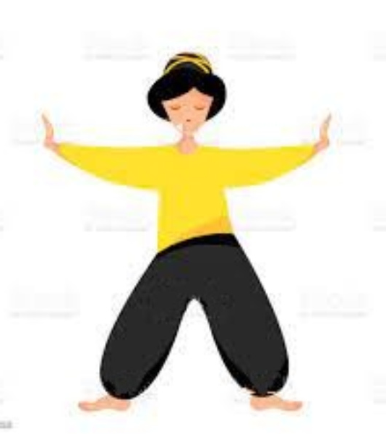
Hunyuan Qigong

Slide 9


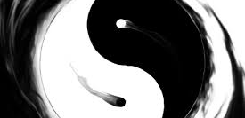
Thank You for Attending Hunyuan Qigong Session☺

