Slide 1
Team-based Healthcare
presented by
Michael Schneider DC, PhD
Professor, School of Health & Rehabilitation Sciences
University of Pittsburgh, Pittsburgh PA

Slide 2
Which best describes how you self-identify your professional role in healthcare?
A. Alternative
B. Complementary
C. Integrative
D. Primary Care

Slide 3
Team-based care requires Integration
The ‘CAM’ professions are undergoing a change from ‘Alternative’ to ‘Integrative’’

Slide 4

We overcame many obstacles
during the past 30 years!
Integrative
Complementary
Alternative

Slide 5
Alternative, Complementary or Integrative?
1991
U.S. Congress establishes the Office of Alternative Medicine (OAM) within the National Institutes of Health (NIH)
Congress authorizes making the OAM into an independent Center at the NIH, calling it the National Center for Complementary and Alternative Medicine (NCCAM)
Eisenberg et al publish first survey of CAM use in the U.S.
The Institute of Medicine releases a report on Complementary and Alternative Medicine in the United States, funded by NCCAM
Congress renames NCCAM the National Center for Complementary and Integrative Health (NCCIH)
1998
2001
2005
2014

Slide 6


Slide 7
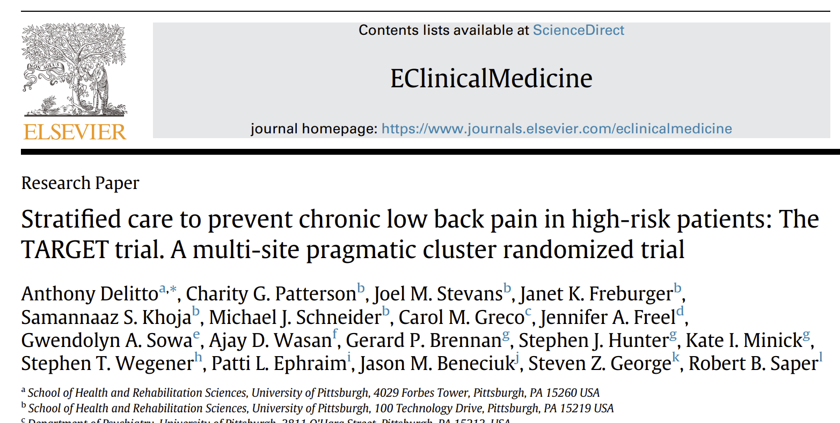
System challenges – demonstrates the difficulty of changing current pathways
Despite creating an automated process of identifying high-risk patients and generating referrals for matching PIPT, only half received a referral to PIPT in the stratified group compared to a third of patients receiving a referral to PT in the usual care group
Future work should focus on solving implementation challenges, perhaps by considering hybrid designs

Slide 8

Chiropractic Care
The use of chiropractic care by U.S. adults increased from 9.1 percent in 2012 to 10.3 percent in 2017.
Among the survey’s other findings in U.S. adults:
Women were more likely than men to see a chiropractor (11.1 percent versus 9.4 percent).
Non-Hispanic white adults were more likely to visit chiropractors compared with Hispanic and non-Hispanic black adults.
The use of chiropractic care was higher among adults aged 45 to 64 years compared with younger and older age groups.

Slide 9
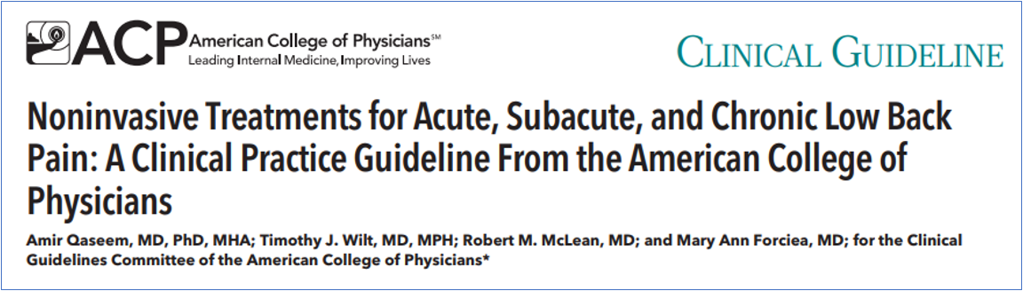
Qaseem A, Wilt TJ, McLean RM, Forciea MA. Noninvasive Treatments for Acute, Subacute, and Chronic Low Back Pain: A Clinical Practice Guideline From the American College of Physicians. Ann Intern Med. 2017;166(7):514-30.

Slide 10
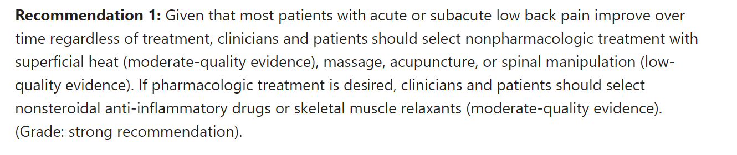

Slide 11
What do you think is the most commonly recommended CHA for acute back pain?
A. Spinal manipulation
B. Massage therapy
C. Acupuncture
D. Exercise

Slide 12
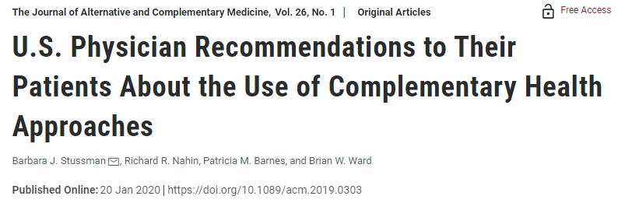
Most commonly recommended CHAs::
Chiropractic/osteopathic manipulation (54.0%)
Massage therapy (52.6%)
Herbs/non-vitamin supplements (26.5%)
Yoga (25.6%)
Acupuncture (22.4%)
More likely to refer to CHA:
Female vs. Male
DO vs. MD
Age < 65 years
Personal use of CHA
53.1% of U.S. physicians recommended at least one CHA to their patients in the past 12 months.

Slide 13
So… have we moved from “alternative” to
“integrative”?

Slide 14

Unfortunately, most healthcare is still delivered in silos
Medicine
Chiro
Acu
Massage

Slide 15

Integrative care is team-based care

Slide 16
Would you describe your current clinical setting as incorporating interprofessional team-based care?
A. Yes, I work with other professionals
B. No, I don’t incorporate other professionals at this time
C. No, but working towards integration

Slide 17
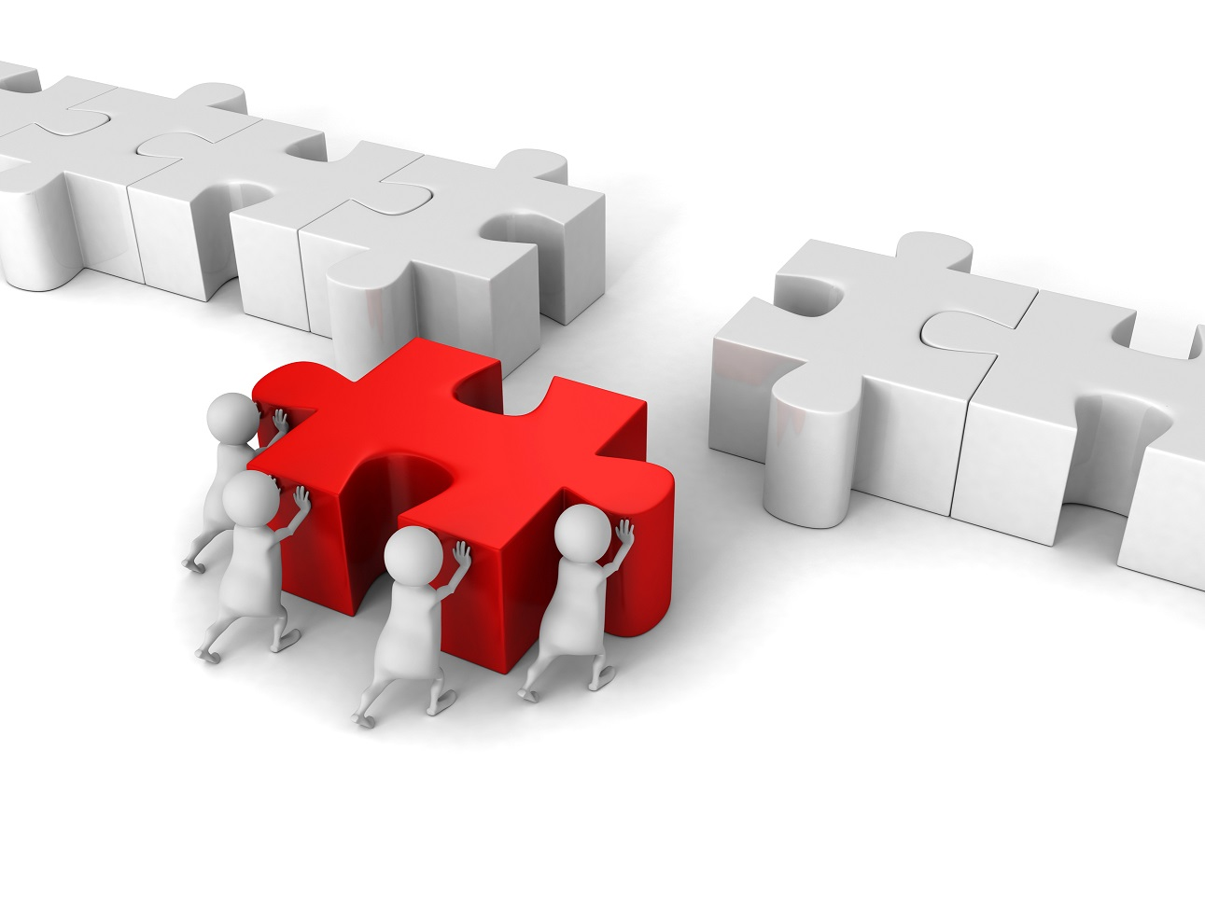
How do we become integrated into a healthcare team?

Slide 18

Integration will not happen by chance…it requires change!

Slide 19
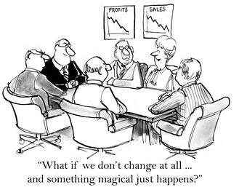

Slide 20

“it is not the strongest of the species that survives, nor the most intelligent, but the one most responsive to change.”
- Charles Darwin, 1809

Slide 21


Embrace 5 key changes for integration
Changing from ‘lone wolf’ to ‘team player’
Inter-professional communication skills
Evidence-based practice
Biopsychosocial model
Social determinants of health

Slide 22


1. Adopt the mindset of Integration instead of Isolation

Slide 23
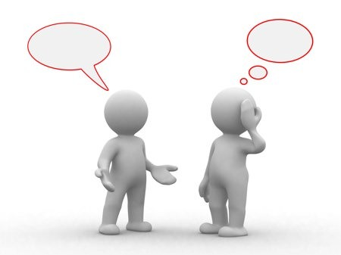
2. Communication with other professionals on the team

Slide 24
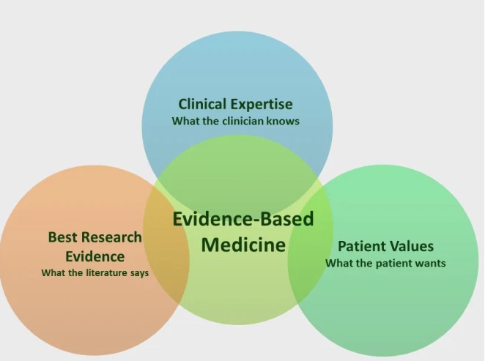
3 . Embrace the evidence-based model of clinical care

Slide 25
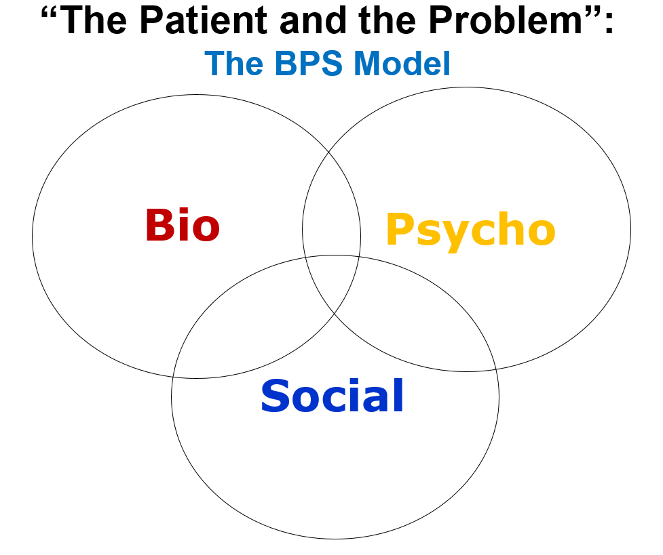
4. Embrace the Bio-Psycho-Social
Model of Health

Slide 26
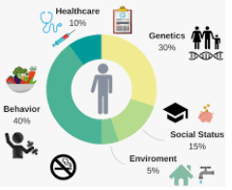
5. Appreciation for the social determinants of health

Slide 27

Thank You!
Michael Schneider DC, PhD
mjs5@pitt.edu

