Slide 1
Information Security in 2021
Preventing Data Breaches from Occurring

Slide 2
Presentation Objectives
Understand key threats to healthcare in with cybersecurity
Define the impact on cybersecurity in the healthcare industry
Comprehend on strong password management can help divert security threats
Identify phishing attempts and understand exploited phishing attempts
Define best practices when accessing Fulcrum electronic systems

Slide 3
Let’s Start with a Look at What’s Happening….
So far in 2021, 576 Data Breaches great than 500 individuals reported
95% of those data breaches are currently under investigation by OCR
Cybersecurity continues to be the biggest threat to the healthcare industry
72% of data breach are due to hacking/IT incident (2021)

Slide 4
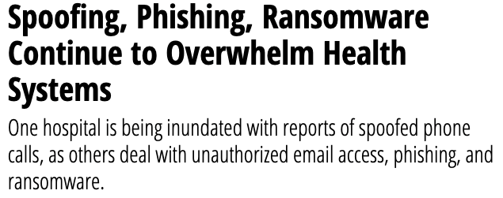
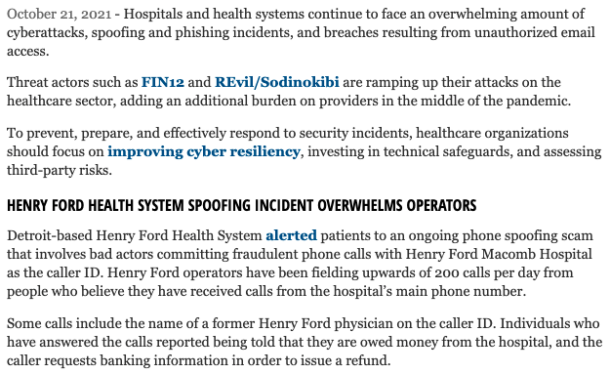
HIPAA Data Breaches – Happy Everywhere
Source: https://healthitsecurity.com/news/spoofing-phishing-ransomware-continue-to-overwhelm-health-systems

Slide 5
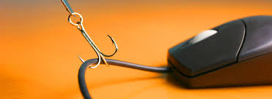
Cybersecurity Attacks focus on the Healthcare Industry
Source: https://healthitsecurity.com/news/spoofing-phishing-ransomware-continue-to-overwhelm-health-systems

Slide 6
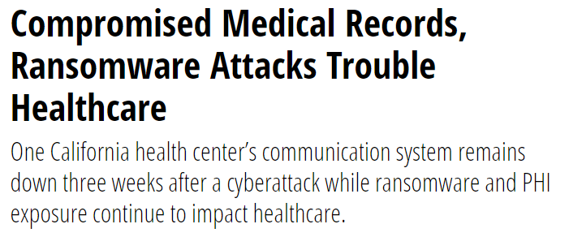
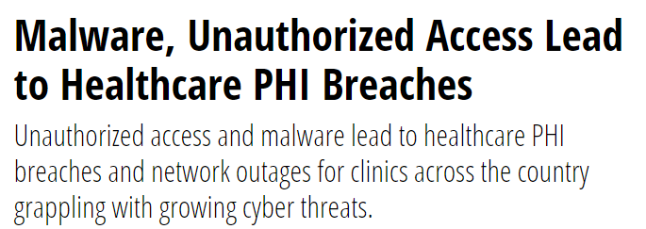
Healthcare Cybersecurity in the Daily New…

Slide 7
Cybersecurity Threats
Hacking
Ransomware
Viruses
Malware Attacks
Phishing Attacks

Slide 8
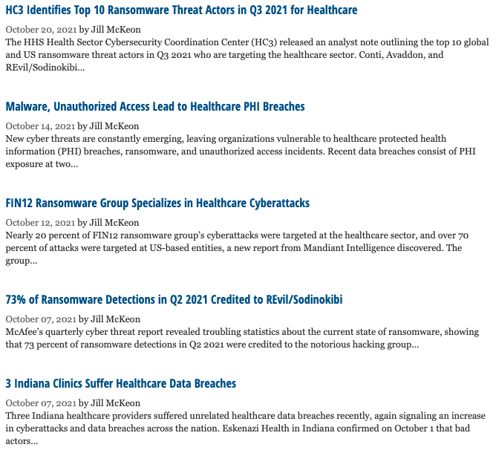
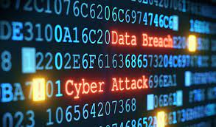
Source: https://healthitsecurity.com/tag/data-breaches

Slide 9
Phishing Emails…

Slide 10
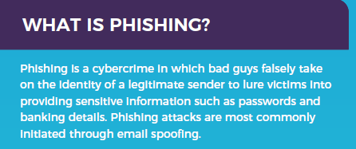
Phishing
Phishing schemes have no specific target and phishing emails often contain spelling errors or other mistakes
Spear Phishing
More personalized with communications appearing to come from a source known to the recipient
Whaling
Spear-phishing attacks aimed at high-profile targets within an organization
Source: https://www.farsightsecurity.com/assets/media/infographics/aopa-infographic.pdf

Slide 11
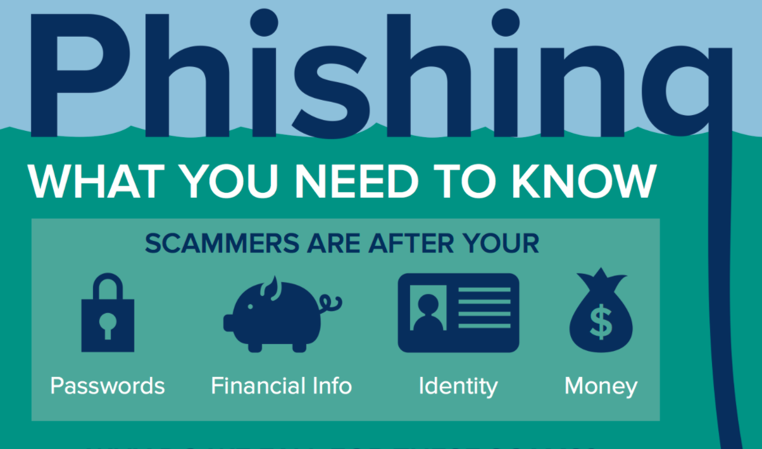
Source: https://uit.stanford.edu/service/phishingawareness/infographic

Slide 12
An unsolicited email is received to a target that seems familiar that contains links or attachments
The target clicks on the link
The link opens to a legitimate looking website that asks the user for their credentials.
Malware may automatically download when the link is clicked
The target submits sensitive information (Credentials, Credit Card Information) and then gets redirected to a different website.
The attacker makes off with the stolen information and can begin using it for malicious purposes
Source: https://www.farsightsecurity.com/assets/media/infographics/aopa-infographic.pdf

Slide 13
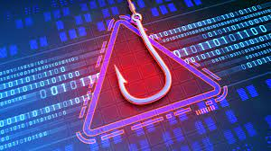
What is Phishing?
Fake lure to get you to provide information
Online scam where an email is sent that appears to be from an actual company and requests that you provide private or sensitive information
Usually by clicking a link
One of the most common ways to hack into a system is by sending an email that will cause an individual to click on a link open an attachment
By clicking a link – you may download malware or initiate a program

Slide 14
Phishing Emails – What Should You Do?
Never Click on the Link
Do not open any attachments on an email
Never provide personal or sensitive information
Do not reply to the senders in any way
If you are concerned about an email
Do Not Forward it to anyone
Report the phishing scam
Delete and then Delete again
If necessary, alert HIPAA Security Officer

Slide 15
Phishing
Email Address
Style of Email

Slide 16
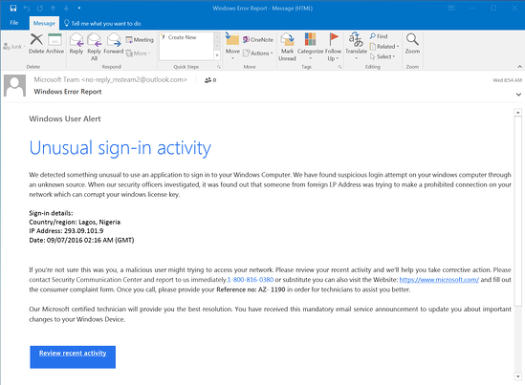
Phishing Attempt Example:

Slide 17
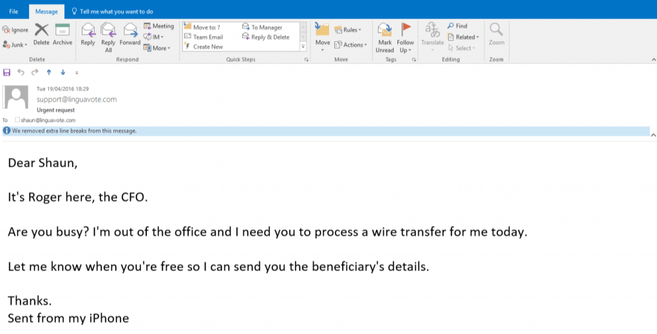
Spear Phishing Attempt Example:

Slide 19
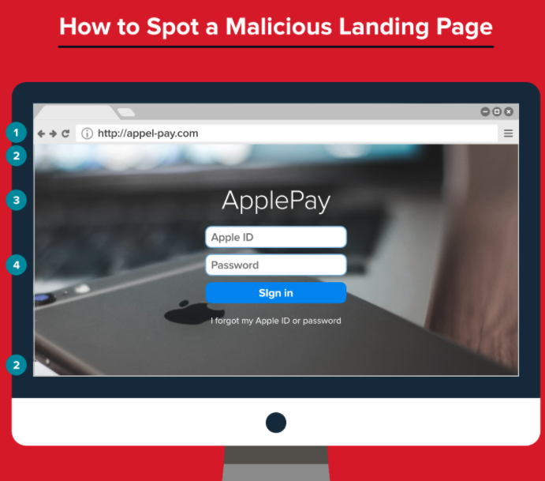
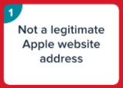
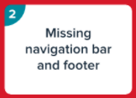
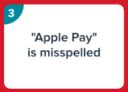
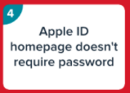
Source: http://anewdomain.net/infographic-how-to-spot-a-phishing-email-every-time/

Slide 20
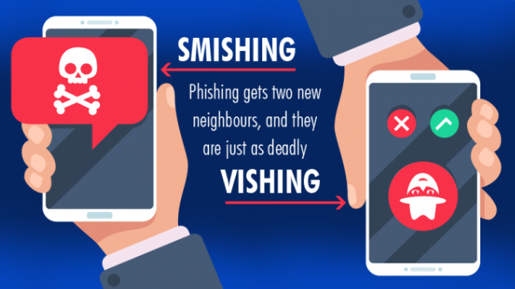

Slide 21
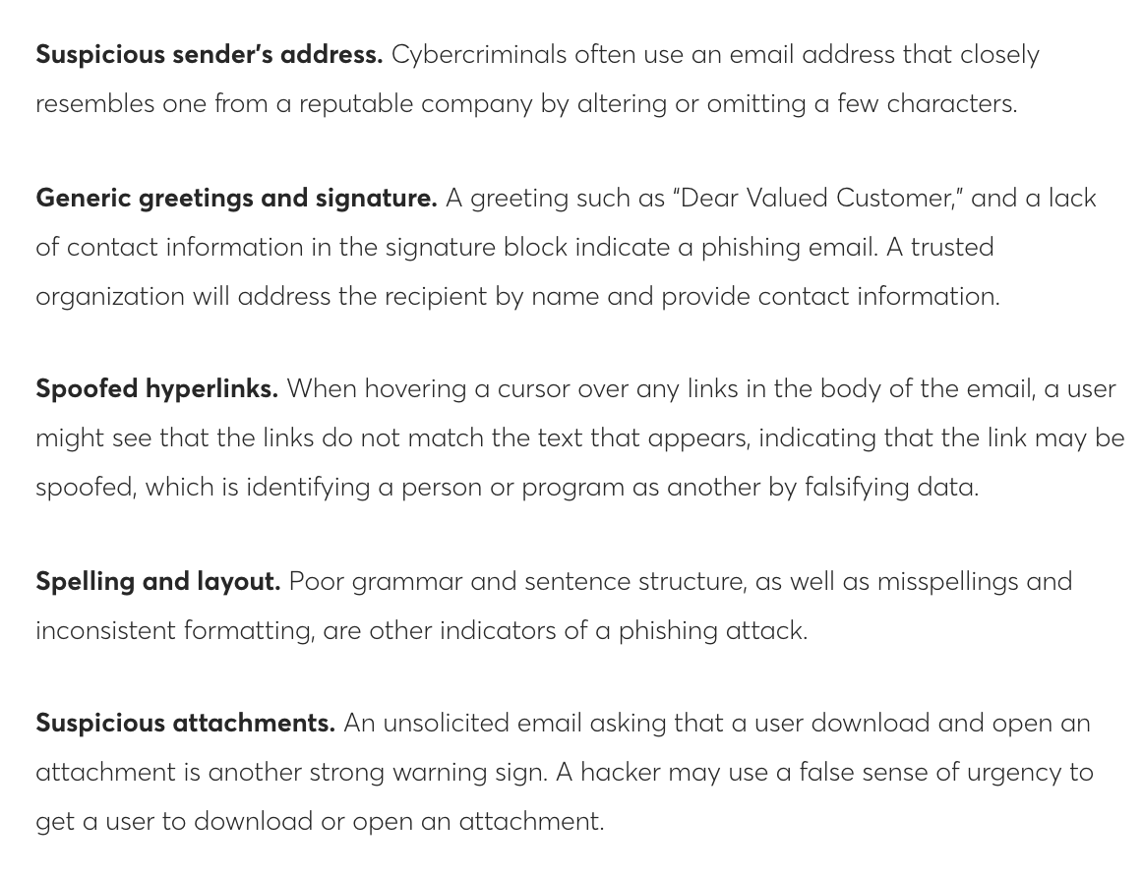
Source: https://www.healthdatamanagement.com/news/new-fed-guidance-helps-providers-stakeholders-avoid-phishing-attacks

Slide 22
Have an Incident Response Plan

Slide 23
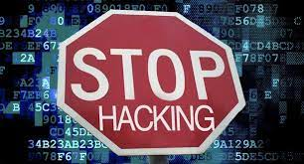
Password Management WORKS!

Slide 24
Password Management
Passwords are the front-line barrier to gaining access to electronic systems or your organization’s network
Strong passwords SHOLD be implemented for all access to systems
Your organization has expectations on the make up of passwords as well as the frequency of changing passwords
Your organization has required safeguards established for password management

Slide 25
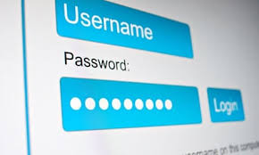
What is a Strong Password?
A strong password is a personalized word or phrase that meets the following:
Minimum of 8 Characters
A Mix of a minimum of 3 of the following:
Uppercase Letters
Lowercase Letter
Numbers
Symbols (@#$%^&*)

Slide 26
Source: https://www.betterbuys.com/estimating-password-cracking-times/

Slide 27
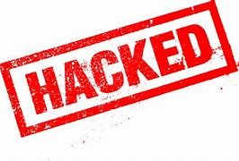
Signs You May Have a Weak Password
The password is widely known to be used by others (123456, password, qwerty)
Your password is made up of commonly known information about yourself (DanikaBrinda1981, MapleGrove55311)
Your password is a superhero plus a number (batman65, supergirl1981)
Your password is backwards (drowssap, 654321)
Your password is a keyboard pattern (qwerty, 1q2w3e4r, !@#$%^123456)
Your password is too short
Your account has been HACKED!

Slide 28
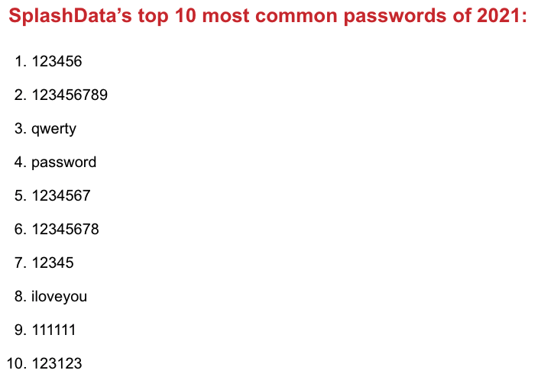
Most Common Passwords of 2021
https://techcult.com/most-common-passwords/

Slide 29
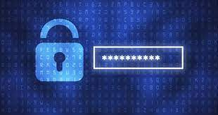
Easy Solutions for Strong Passwords
Solution #1 – Add letters and characters
Replace letters with symbols
@ for the a
! for i
0 for O
Capitalize a letter
Add numbers and/or symbol to the end
P@ssword612!
Solution #2 – 4 to 5 Words Together
Think of 4 – 5 words that resonate with you
Put them together in an order you will remember
Use symbols and numbers
S0ftballD0gsT!nkerbelleSw!mm!ng100904

Slide 30
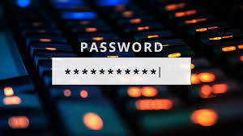
Other Password Reminders?
Do not share passwords
Do not write passwords down
Do not save passwords in web browsers
When leaving a workstation for an extended length of time – Log out
Change passwords as expected and required
Follow password generation expectations, including password strength

Slide 31
User and Access Management

Slide 32
Managing Users in Electronic Systems
User access should be based on role and job responsibility
Users should not receive more access than needed to complete tasks of job
Once a user is terminated from an organization, the user should be ‘deactivated’ or ‘removed’ from the system
Periodic reviews should be conducted to verify that current users are employed by the organization

Slide 33
Thank You!!
Any Questions?

