Slide 1
Mind Over Matter Leveraging Sport Psychology to Enhance Resilience in Healthcare
Ben Merkling, PsyD, LP, CMPC
VP of Clinical Services | Sport Psychologist

Slide 2
Premier Sport Psychology | Premier Performance Advising
20+ professionals who provide mental health and/or mental performance coaching
Specializations include trauma, mood/anxiety disorders, ADHD, addiction, injury recovery, leadership development, team cohesion, high-performance, and more
Comprehensive sport psychology services to multiple professional teams (NBA/WNBA, NFL, NHL, MLB, etc.), Olympic/Paralympic and USA National Teams, DI, DII and D3 collegiate athletic departments and hundreds of club, high school and youth organizations
Individual and group consulting/facilitation (presentations, workshops, sessions, etc.)
Executive coaching, leadership development and consulting services for businesses (Fortune 500, Fortune 100, etc.)

Slide 3
Sport Psychology In A Nutshell…
Sport Psychology can be viewed as “Mindset Management” for peak performance
Know “where” your mind is at in the present moment
Know “where” your mind needs to be to perform at your best
Know “how” to get your mind from where it is in the moment to where it needs to be to perform well
Often, this includes self-talk and “coaching” ourselves to be at our best in any given situation

Slide 4
Self-Awareness: A cornerstone of performance and wellness
What it is: Self-awareness is the conscious knowledge of your own character, feelings, motives and desires.
It involves recognizing your emotions, understanding your thought patterns, and acknowledging how your behavior affects yourself and others.
Why it matters: We cannot be at our best without it.
It empowers you to understand and manage your emotions, adapt your behaviors, and engage with challenges in a way that promotes growth and well-being. Self-awareness can be developed through journaling/reflection, meditation and simply pausing to observe your state of being.

Slide 5
Understanding Resilience
What it is: Resilience is the ability to effectively overcome adversity.
It involves maintaining a positive outlook, adapting to challenging situations, and recovering rapidly from setbacks.
Why it matters: We encounter some level of adversity nearly everyday, and resilience allows us to maintain high performance and wellness through those experiences.
It includes growing and developing through obstacles and is a skill that can be strengthened.

Slide 6
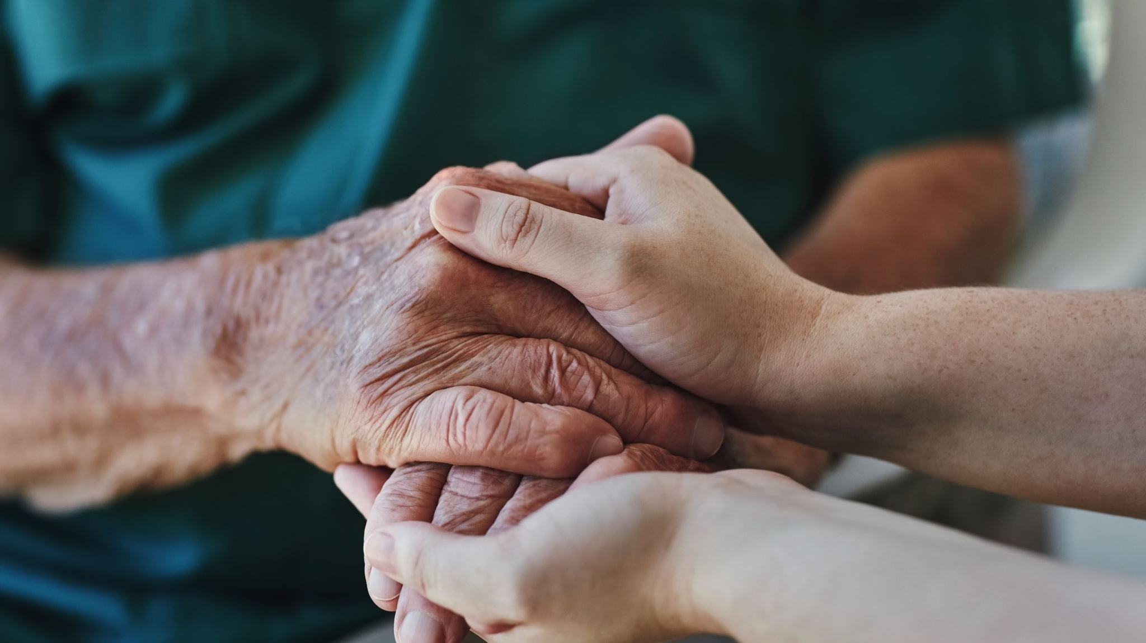
Benefits of Resilience
For healthcare professionals¹…
Prevent burnout
Cope effectively with stress
Decrease symptoms of depression and anxiety
Provide better patient outcomes
For patients²…
Overall quality of life
Cope effectively with emotional distress
Maintain good health habits
Experience better health outcomes
¹(Roberts & Jones, 2023)
²(Sturgeon & Zautra, 2010)

Slide 7
Resilience in High-Performing Individuals
Performance Under Pressure: Mental resilience allows individuals to maintain focus and perform consistently under pressure.
Emotional Stability: Resilient individuals manage stress and emotions effectively, leading to healthy personal and professional lives.
Mental Recovery: It helps in rapidly overcoming failures and setbacks, ensuring that one poor performance doesn’t affect the next.
Physical Recovery: Mental resilience has been shown to aid in quicker and more effective recovery from physical injuries and lessen fatigue.

Slide 8
3 Effective Resilience Strategies
Taking the challenge “head on!”
Using the SERR model
Developing a growth mindset

Slide 9
Exercise
Imagine you’re driving to work and…
There’s unexpected traffic
You’re going to be late for your first patient
You realize you’re double-booked – TWICE!
Your kid has a game they don’t want you to miss…which you might
You just remembered you are delivering a presentation tomorrow morning, and you haven’t had time to prepare anything
How do you feel?

Slide 10
Take it “Head On!”
Taking the challenge “head on” is the process of…
Pausing to notice we’re feeling overwhelmed by the circumstances
Deciding to “fight” or compete with the challenge in front of you
Tapping into determination to overcome it
“Hitting” it…before it hits you
We do this through self-talk and focusing on the controllable steps of the process

Slide 11
Exercise
Imagine you just arrived home after a stressful day at work, and as you walk to the couch, you step on a LEGO…
Immediately pain races up your foot, even radiating into your lower leg
You just cleaned the house yesterday, and yet there are toys covering the ground… again
You partner is sitting on the couch scrolling on their phone
How do you initially want to respond?

Slide 12
SERR Model
Behaviors dictate results
Accept the SITUATION
Accept the EMOTION
Focus on your RESPONSE
Your response determines the RESULT
The SERR model can be used to intentionally prepare and respond to adversity to drive more optimal results – no matter the situation or how you feel

Slide 13
Exercise
Imagine the first time you learned to ride a bike (or tried something new)…
Everyone else seemed to know how
You kept making mistakes
You looked silly (really, really silly)
You got frustrated
Maybe you felt defeated or deflated
You kept trying
You eventually improved and learned!
What made it possible for you to do so?

Slide 14
Growth Mindset
A growth mindset is…
The belief that your abilities can grow and develop
Focusing on growth and trying to improve
Openness to new experiences
Willingness to step outside your comfort zone
Accepting that mistakes and failures happen to all of us
Giving yourself GRACE when you experience setbacks – which is difficult, but critical to overcoming adversity
Learn, burn, return!

Slide 15
Integration & Implementation
For self:
Implement resilience-building strategies in the midst of adversity.
Reflect on the adversity with a growth mindset and GRACE.
For Patients:
Use resilience-based language.
Help them focus on their response to their circumstances.
When encountering adversity, pause and notice your reactions.
“We’re going to overcome this!”
Guide them to a growth mindset that focuses on gradual improvements and progress.
Take a “head-on” approach to their care and communicate this in your interactions.

Slide 16
References
Roberts, T., & Jones, C. (2023). Promoting resilience in healthcare professionals: A narrative review. Journal of Healthcare Management, 68(2), 107-120.
Sturgeon, J. A., & Zautra, A. J. (2010). Resilience: A new paradigm for adaptation to chronic pain. Current Pain and Headache Reports, 14(2), 105–112. https://doi.org/10.1007/s11916-010-0095-9

Slide 17
Thank you!
Questions?

