Slide 1
Cervical spine pain in the concussion patient. An understanding of the current literature
Jeff King DC, MS
Notes:
Thank
Faith/Girls
Jen and Brian: tough little brother etc.
Dr. Joe Sturges: Tell story of how I got there. saw how it can be done. Ethical. Family
Norman: Mentor in school and out. Helmet story, APS story.
Thank McCrea, Nelson, Cheever

Slide 2
outline
Define concussion
Genesis of the research question
Basic statistics/symptoms
Neck pain statistics/whiplash statistics
Cervicogenic dizziness???
Prevalence of neck pain in concussion/predictors
Impact of neck pain on recovery
Does treatment matter?
Current/future projects

Slide 3
KEY ASSUMPTIONS
We can make this day fun!
The more interactive we are the better this will be
I am not infallible
It’s okay to disagree
Please ask questions

Slide 4
A little about me

Slide 5

22333
Or…
Pollev.com/jeffking443
jeffking443

Slide 6

Notes:
How often do you treat patients with concussions
http://www.polleverywhere.com/multiple_choice_polls/7kHA4S05nlwoslpxibDQK

Slide 7
Notes:
When a new patient comes in that has a concussion you think?
http://www.polleverywhere.com/free_text_polls/PIqeSmJnBO3YH7aJHGnbB

Slide 8
Notes:
All mild traumatic brain injuries are concussions
http://www.polleverywhere.com/multiple_choice_polls/qpP2PjjKVPM8C8O9aBqVS

Slide 9
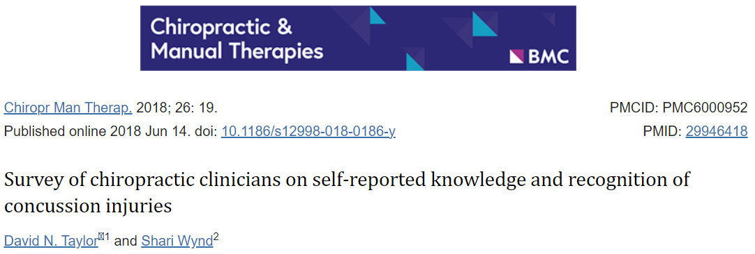
Why is this class needed?

Slide 10
Survey of 54 chiropractors
The self-reported MTBI knowledge, recognition and treatment by chiropractic practitioners is incongruent with the knowledge demonstrated via the knowledge survey items answered by the chiropractic physicians.
There appears to be overconfidence in the recognition of MTBI by the practitioners without the demonstrated knowledge.
Further doctoral education and continuing education in recognition of mild traumatic brain injuries is needed.

Slide 11
What is a concussion?
Sport-related concussion is a traumatic brain injury caused by a direct blow to the head, neck or body resulting in an impulsive force being transmitted to the brain that occurs in sports and exercise-related activities.
This initiates a neurotransmitter and metabolic cascade, with possible axonal injury, blood flow change and inflammation affecting the brain. Symptoms and signs may present immediately, or evolve over minutes or hours, and commonly resolve within days, but may be prolonged.
No abnormality is seen on standard structural neuroimaging studies (computed tomography or magnetic resonance imaging T1- and T2-weighted images), but in the research setting, abnormalities may be present on functional, blood flow or metabolic imaging studies.
Sport-related concussion results in a range of clinical symptoms and signs that may or may not involve loss of consciousness. The clinical symptoms and signs of concussion cannot be explained solely by (but may occur concomitantly with) drug, alcohol, or medication use, other injuries (such as cervical injuries, peripheral vestibular dysfunction) or other comorbidities (such as psychological factors or coexisting medical conditions).
Patricios JS, et al. Consensus statement on concussion in sport: the 6th International Conference on Concussion in Sport- Amsterdam, October 2022. BR J Sports Med 2023;57:695-711
Notes:
A concussion is not a brain bruise
No need for radiographic findings
WE DON”T GRADE CONCUSSIONS

Slide 12
Typical recovery
70-90% resolve in a typical manner
14 days for adults
27 days for adolescents and children.
McCrory P, Meeuwisse W, Dvorak J, et al. Consensus statement on concussion in sport-the 5th international conference on concussion in sport held in Berlin, October 2016. Br J Sports Med.2017;51(11):838–47.
Broglio SP, Cantu RC, Gioia GA, et al. National Athletic Trainers’ Association position statement: management of sport concussion. J Athl Train. 2014;49(2):245–65.

Slide 13

Why this line of inquiry?
Notes:
Story of patients seen.

Slide 14
Case Study
20 Year old Female with Persistent Concussion Symptoms.
Notes:
Mother PCP in our system

Slide 15
Initial Presentation
Fell water skiing 5 weeks prior to presenting
  “Hyperextended her neck”
Neck pain 0-6/10
HA 1-6/10
  Associated mental fogginess
Can walk 30-40 minutes
Any strenuous activity increases symptoms
Quit summer job due to symptoms
3 years ago concussion during volleyball took 5-6 months to be cleared for activity
Notes:
Concerned as she was in a very competitive academic/degree program and was worried about her ability to keep up with the requirements

Slide 16
Exam Findings
Neuromotor intact including CN and UMN exam
PCSS 40/132
PSFS 3.66 reading, running, tv/screen use
NDI 36%
Orthopedic exam revealed tenderness to palpation in the sub occipital musculature and cervical paraspinal musculature, decreased and painful C/S ROM. Passive joint play assessment revealed stiffness in the upper to mid thoracic spine as well as well as the upper cervical spine.
Notes:
Describe PSFS

Slide 17
Treatment
Visit #1/Exam: given chin tucks and stretching exercises
Visit #2: improvement in baseline symptoms, manipulation upper cervical spine, upper to mid thoracic spine, MFR suboccipial and C/S paraspinal musculature. Asked patient to find baseline on incline treadmill
Visit #3: minimal HA/fog that day baseline 15 minutes on treadmill. Walk 2-3 times per day. Same manual therapy
Visit #4: doing “really well” with entire days symptom free tolerating 2 20-minute walks daily, symptoms less intense when present. Increase to two 25 minute walks.
Visit #5: little to no significant headache. When it is present she can resolve it with HEP. 20 minute walk/run
Visit #6: Only minimal headache with running that resolves on its own

Slide 18
Outcome measures
PCSS 40/132
PSFS 3.66
NDI 36%
PCSS 2/132
PSFS 8.66
NDI 2%
Notes:
Highlight that a fairly standard whiplash protocol decreased “concussion symptoms”.

Slide 19
How did you treat her concussion?

Slide 20

Symptoms
Emotional
Irritability
Sadness
More emotional
Nervousness
Cognitive
Feeling “foggy”
Feeling “slowed down”
Difficulty concentrating
Difficulty remembering
Forgetful of recent information
Confusion about recent events
Answer questions slowly
Repeats questions
Physical
Headache
Nausea
Vomiting
Balance problems
Dizziness
Visual Problems
Fatigue
Light sensitivity
Noise sensitivity
Numbness/ Tingling
Dazed or stunned
Sleep
Drowsiness
Sleeping less than usual
Trouble falling asleep
CDC. Traumatic Brain Injury. Acute Concussion Evaluation (ACE) - Physician/Clinician Office Version (cdc.gov). Accessed June 28 2022
Notes:
See a wide variety of symptoms across many systems

Slide 21

Was something missing?
Notes:
Highlight no neck pain and bring up discussion regarding “cervical concussion discussion”

Slide 22
How common is neck pain in the setting of concussion?

Slide 23
Notes:
How common is neck pain in concussion patients
http://www.polleverywhere.com/multiple_choice_polls/wOBZSVX9keZ6ocoKvuCBA

Slide 24
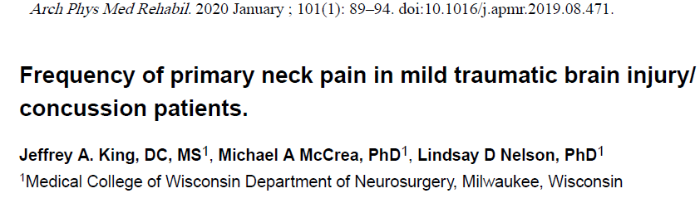
95 patients presenting to Level I trauma center with mTBI symptoms and event that could have caused mTBI
Objectives
  Determine the frequency of neck pain overall and relative to other symptoms
  Determine the predictors of neck pain in this population.
Notes:
Explain how we defined neck pain

Slide 25
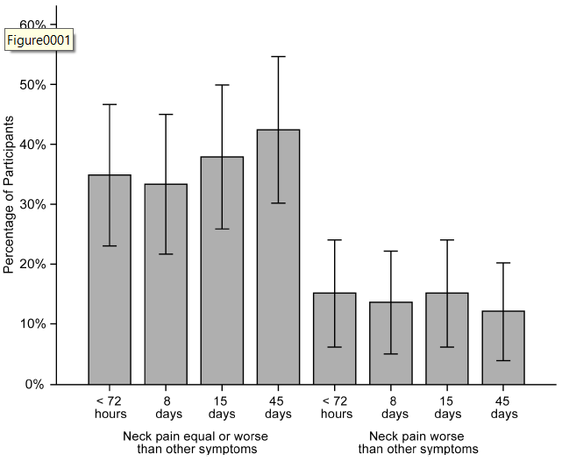
Neck pain is common in this population
Notes:
frequency of any reported neck pain was 68.4%, 50.6%, 49%, and 41.9%
The frequency of any reported neck pain was 68.4%, 50.6%, 49%, and 41.9% within 72 hours and at 8, 15, and 45 days, respectively

Slide 26
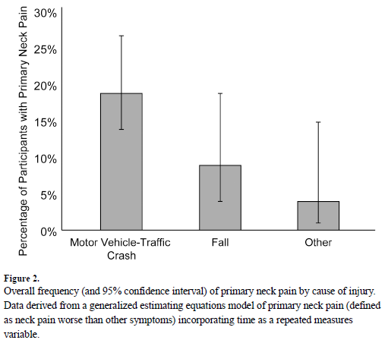
Mechanism of injury predicts neck pain
Notes:
Patients with MVC more likely to have Primary neck pain. Likely whiplash. Also highlight Canadian MVC “hit head” study.

Slide 27
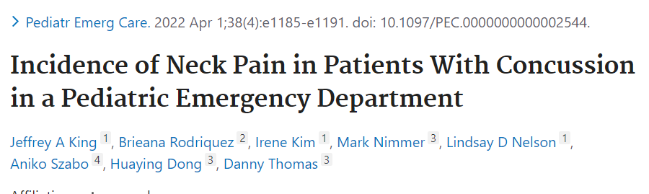
Retrospective chart review of 652 patients diagnosed with mTBI/Concussion in a pediatric level I trauma center
Objectives
to determine the frequency of neck pain in patients diagnosed with mild traumatic brain injury (mTBI) or concussion in a pediatric level 1 trauma center emergency department
to identify variables associated with neck pain in this population
Identify if patients with neck pain seek more follow up care.
to report on aspects of care received in the ED including imaging and medication use.

Slide 28
90 (13.8%) reported neck pain.
Acceleration/deceleration injury and motor vehicle accident were predictive of neck pain.
There was no significant difference between groups with respect to concussion-related follow-up visits or follow-up visits to a dedicated concussion clinic.
Notes:
Believe parents more likely to bring children in for simple injuries than they would themselves.

Slide 29
Why less neck pain in kiddos?
Notes:
Believe parents more likely to bring children in for simple injuries than they would themselves.

Slide 30
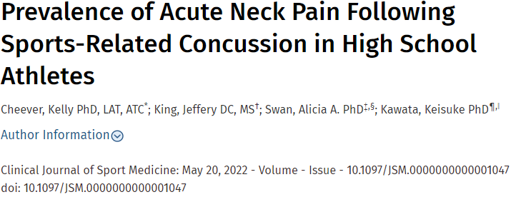
Prospective study of 401 high school athletes
Objectives
  To explore the prevalence of acute neck pain in high school athletes following sports-related concussion (SRC) and
  To examine the role of acute neck pain in modifying or amplifying concurrent concussive symptoms.
Notes:
Describe what the dataset is. Thank Kelly. FIL is a DC

Slide 31
One hundred thirty-eight of 401 athletes (33.9%) indicated acute neck pain following SRC.
Those with neck pain reported significantly more symptoms overall (M = 13.53, SD = 6.89) relative to their non–neck pain counterparts (M = 8.46, SD = 5.68; t [191.35] 5 7.11, P , 0.001).
Athletes with SRC due to contact with a surface were significantly less likely to report neck pain than those reported contact with a person.
Neck pain, repeated injury, and female sex were significantly associated with a greater number of concussion symptoms in the acute phase.

Slide 32
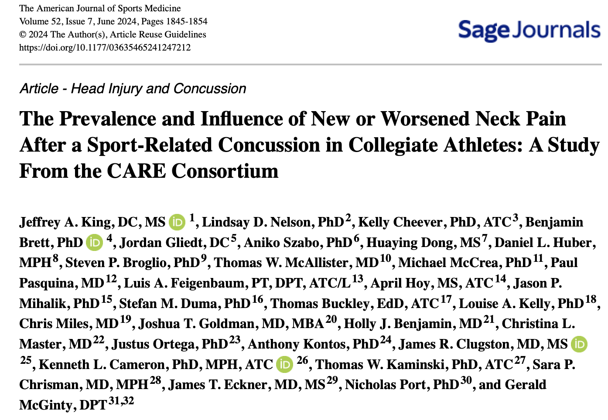

Slide 33
Varsity-level athletes from 29 National Collegiate Athletic Association member institutions as well as non-varsity sport athletes at military service academies were eligible for enrollment.
2163 Injuries enrolled
Participants completed a preseason baseline assessment
Follow-up assessments at
  6 and 24-48 hours after a concussion
  when they were symptom-free
  when they returned to unrestricted play

Slide 34
47% reported new onset or worsened neck pain following concussion
Factors that were associated with new/worsened neck pain
  Player contact with playing surface
  Sex
Outcome
  Greater number of days with symptoms and longer to return to normal academic performance

Slide 35
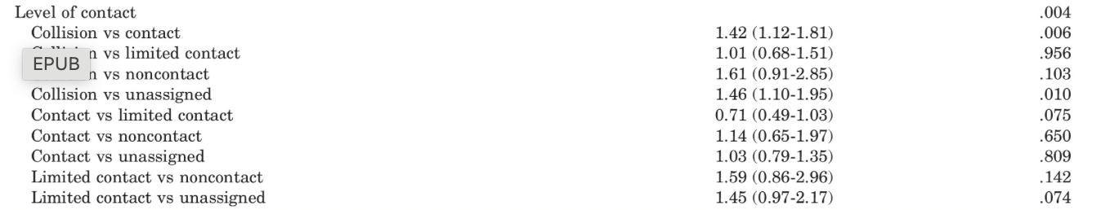
Does level of contact matter?

Slide 36
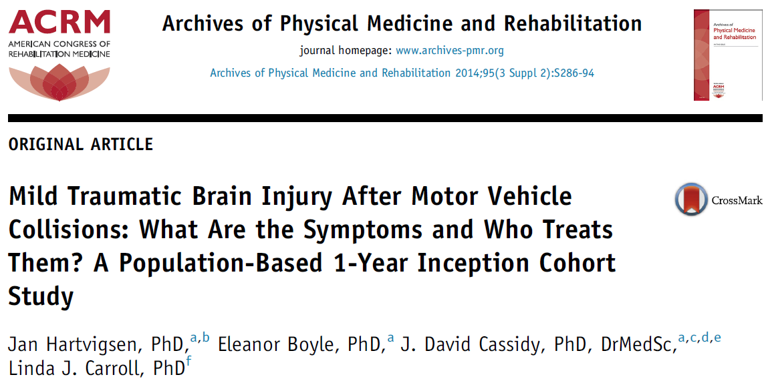

Slide 37
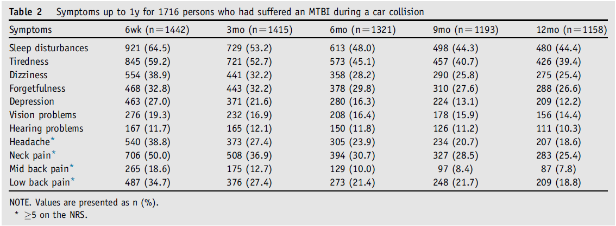

Slide 38
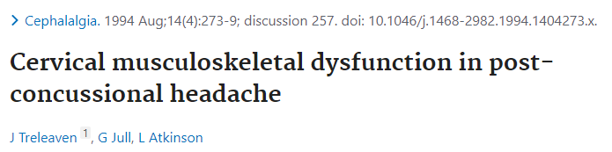

Slide 39
12 patients with post concussion headache (PCH) compared to 12 healthy age matched controls
10 of 12 in (PCH) showedpainful upper cervical segmental joint dysfunction
PCH had less endurance in the neck flexor muscles and a higher incidence of moderately tight neck musculature.
Active range of cervical motion and postural attitude were not significantly different between groups.
As upper cervical joint dysfunction is a feature of cervicogenic causes of headache, the results of this study support the inclusion of a precise physical examination of the cervical region in differential diagnosis of patients suffering persistent headache following concussion.

Slide 40
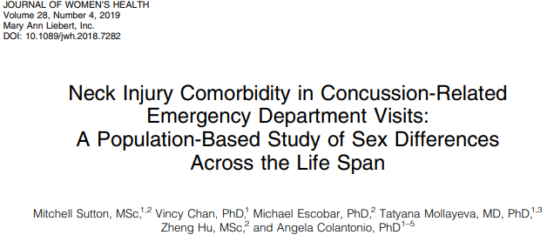

Slide 41
90,175 concussion related ED visits in Ontario.
Neck strain identified by diagnosis in ED
Females 4,333/100,000
Males 2,995/100,000
This held true across mechanism of injury.
Neck strain 2.89 times higher in MVC vs all other causes

Slide 42
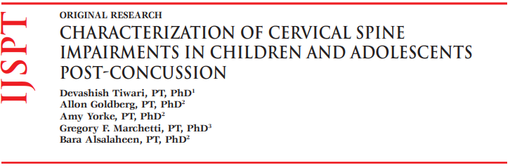

Slide 43
Review of 73 patients referred for cervical physical therapy following concussion.
Assessed in five categories
  Posture/generalized hypermobility
    Beighton scale
    Postural assessment
  Myofasical tension to palpation
  Joint mobility
    ROM/Pain
    Segmental mobility testing
    Rib mobility
  Muscle strength/endurance
    Manual muscle testing 5/5
    Neck flexor endurance test
    Cranio/cervical flexor test
  Proprioceptive testing
    Joint position error test
      4.5-7mm significant
  Spurlings

Slide 44
99% of patients demonstrated impairments in at least three out of five assessment categories
55% demonstrated impairments in at least four out five assessment categories.
Of the five assessment categories
  posture (99%)
  myofascial impairment (98%)
  joint mobility (86%)
  muscle strength (62%)
  Cervical joint proprioception (19%)
  Radiculopathy (0%)

Slide 45


Slide 46
5,815 were identified and retrospectively reviewed.
  3,040 sport related concussion (SRC)
  2,775 non-sport related (non-SRC)
Diagnosed neck injury higher SRC (7.2%) than non-SRC (12.1%) p<
Neck injury diagnoses were significantly more prevalent in females overall (p < 0.000)
Similarly, female-to-male neck injury proportion ratios were significantly higher in females in non-SRCs compared to SRCs (IPR 1.90, 95% CI 1.60 to 2.25, p < 0.000).

Slide 47
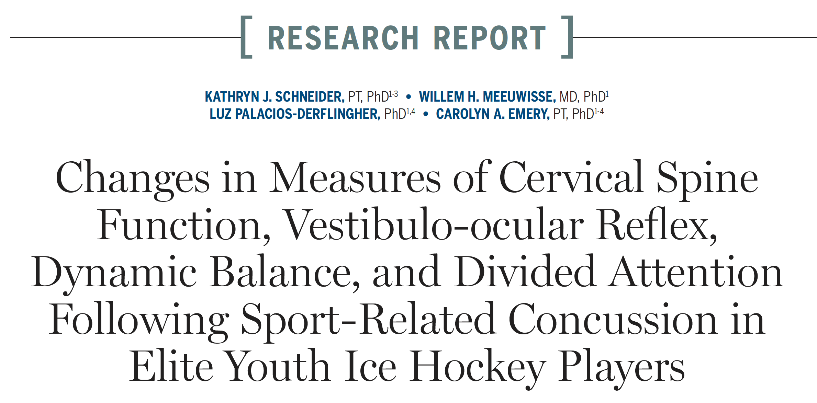

Slide 48
69 13-17 y/o youth hockey players
  evaluate the acute changes in measures of
    (1) cervical spine function
    (2) vestibulo-ocular function
    (3) dynamic balance
    (4) tasks of divided attention in elite youth ice hockey players who have suffered a sport-related concussion.

Slide 49
What did they measure?
symptom reports (ie, neck pain, dizziness, headaches on a numeric pain or dizziness rating scale [0-10])
cervical spine function (cervical spine range of motion, cervical flexor endurance [CFE] test cervical flexion rotation test,31 anterolateral cervical spine strength test,joint position error [left rotation, right rotation, and extension])
Vestibuloocular function (clinical dynamic visual acuity [DVA], head thrust test, computerized DVA)
Dynamic balance (Functional Gait Assessment)
Divided attention (walking-while-talking test).

Slide 50
What did they find?
Variable | Pre-season | Post-injury
Neck pain | 29% (n=16) | 47% (n=26)
Headache | 31% (n=17) | 64% (n=35)
Dizziness | 21% (n=10) | 48% (n=23)
Decreased performance on cervical spine measures was noted in the early days following concussion,
Vestibulo-ocular function and dynamic balance did not change following concussion.

Slide 51
Notes:
Does neck pain influency recovery?
http://www.polleverywhere.com/multiple_choice_polls/F8ephSal4PDoXKUjBe66O

Slide 52

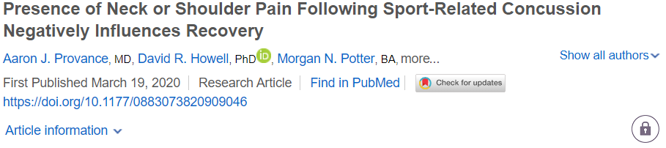
580 pediatric patients with sport related concussion
312 reported neck pain (53.79%)
Those with neck pain reported longer duration of symptoms and were more likely to miss greater than 5 days of school

Slide 53
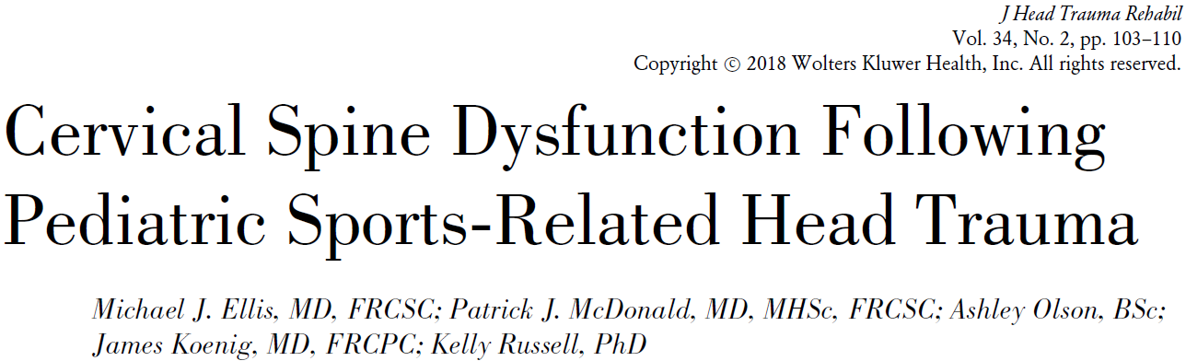
266 patients (6-19 y/o diagnosed with Sport Related Concussion.

Slide 54
CSD defined as neurological symptoms localized to the cervical spine or the presence of neck pain, headache, or dizziness and abnormal cervical spine examination findings
Excluding patients with central cord neuropraxia OR SCIWORA, patients with SRC with CSD took longer to achieve physician-documented clinical recovery
(28.5 days vs 17 days, P < .0001) and were 3.95 times more likely to experience delayed physician-documented clinical recovery (>4 weeks postinjury) compared with those without CSD
Notes:
Spinal Cord Injury Without Radiographic Abnormality
More Broad/severe definition.

Slide 55
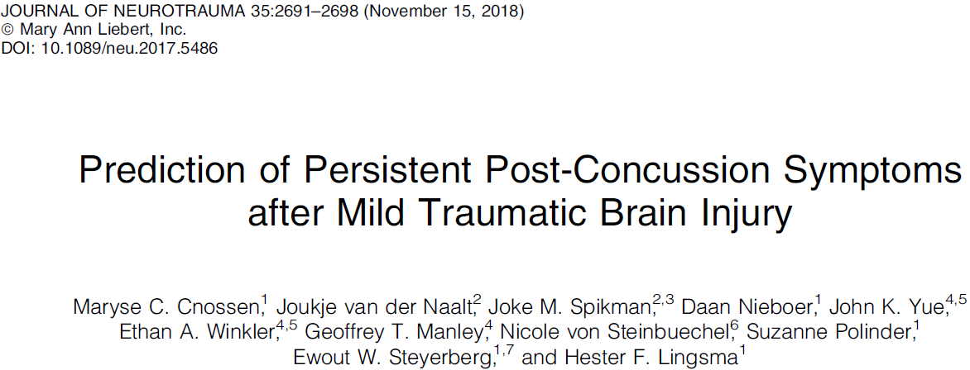
591 patients presenting to ED diagnosed with Concussion
120 (20%) reported neck pain
Patients with neck pain 2.58 times more likely to have persistent post-concussion symptoms

Slide 56
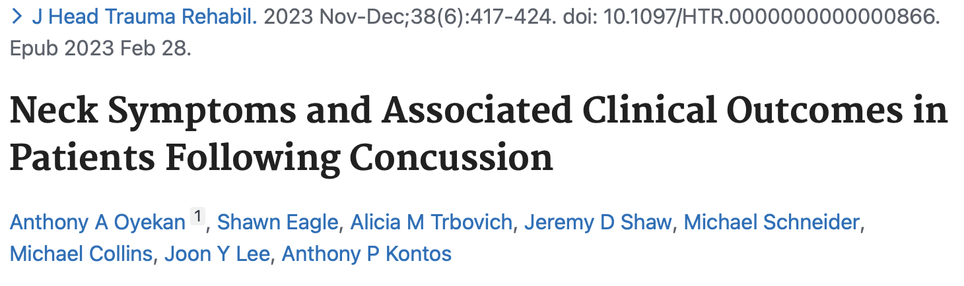

Slide 57
Retrospective study of 331 patients enrolled in concussion clinic
145 (47%) reported neck pain (0-3)
68 (22.2%) reported difficulty moving their neck
A total of 47 (15.4%) participants reported more severe neck symptoms, (>1.5)
  Took longer to recover (40 ± 27 days)
  not reporting neck symptoms (30 ± 28 days; U = 8316, P < .001).
MVCs and falls were associated with over 4 times and 2 times greater risk, respectively, for reporting more severe neck symptoms.

Slide 58
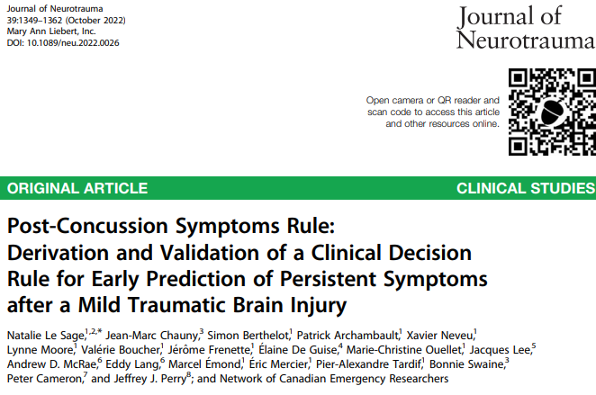

Slide 59
Patients recruited from 7 EDs across Canada at academic medical centers presenting within 24 hours of injury and over age 14.
Followed at 7,30, and 90 days
1083 patients
  471 in derivation cohort
  612 in validation cohorts
Those with neck pain in the ED 2.53 times more likely to develop PPCS
At 7 days 4.33 times more likely

Slide 60
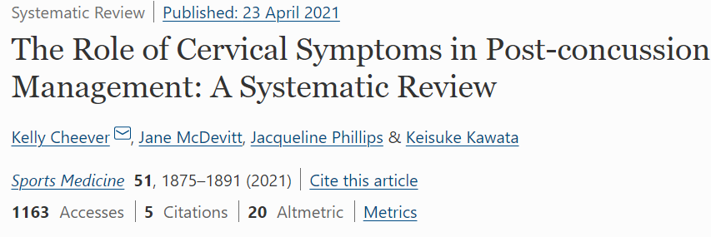
Cervicogenic symptoms are prevalent in the acute and chronic stages following concussion, which if not diagnosed
appropriately increase the likelihood of PPCS. Several clinical tests are available to help differentiate cervicogenic
symptoms; however, lack of awareness and hesitation by practitioners limits their use. More randomized controlled trials are necessary to evaluate the effectiveness of cervical specific treatment programs for PPCS.

Slide 61
Why neck pain after concussion?

Slide 62
Whiplash?

Slide 63
Forces required for injury
Whiplash
Concussion
4.5 G
Spitzer WO, Skovron ML, Salmi LR, Cassidey JD, Duranceau J, Suissa S, et al. Scientific monograph of the Quebec Task Force on Whiplash-Associated Disorders: redefining whiplash and its management. Spine 1995;20:1S–73S
60 and 160g
highest predictive occurrence occurring at 96.1g
Broglio SP, Surma T, Ashton-Miller JA. High school and collegiate football athlete concussions: A biomechanical review. Ann Biomed Eng 2011;40:37–46.

Slide 64
Little Players: Big Hits
7-8 year old football players
  Median 16g
  95th percentile 38g
  161 impacts per season
High School football players
  Median 21g
  95th percentile 56g
  565 impacts per season
Collegiate football players
  Median 18g
  95th percentile 63g
  1000 impacts per season
Cobb BR et al. Head Impact Exposure in Youth Football: Elementary School Ages 9-12 Years and the Effect of Practice Structure. Annals of Biomedical Engineering. Dec 2013 (41) 12: 2463-2473
Young TJ et al. Head Impact Exposure in Youth Football: Elementary School Ages 7-8 Years and the Effect of Returning Players. Clinical Journal Sports Medicine 2013 (0) 0: 1-6
Urban JE et al. Impact Exposure in Youth Football: High School Ages 14 to 18 Years and Cumulative Impact Analysis. Annals of Biomedical Engineering. Dec 2013 (41) 2474-2487

Slide 65
Little Players: Big Hits
7-8 year old football players were recorded to have 11 impacts over 80 g
These are hits that would qualify as the 95th percentile in collegiate players
Young TJ et al. Head Impact Exposure in Youth Football: Elementary School Ages 7-8 Years and the Effect of Returning Players. Clinical Journal Sports Medicine 2013 (0) 0: 1-6

Slide 66
Neck strength
Having a smaller/weaker neck is shown to be associated with increased head displacement following an impulse impact
The opportunity to anticipate impact is correlated with decreased head displacement and velocity
Eckner JT et al. Effect of a Neck Muscle Strength and Anticipatory Cervical Muscle Activation on the Kinematic Response of the Head to Impulsive Loads. The American Journal of Sports Medicine (20) 10: 1-11

Slide 67

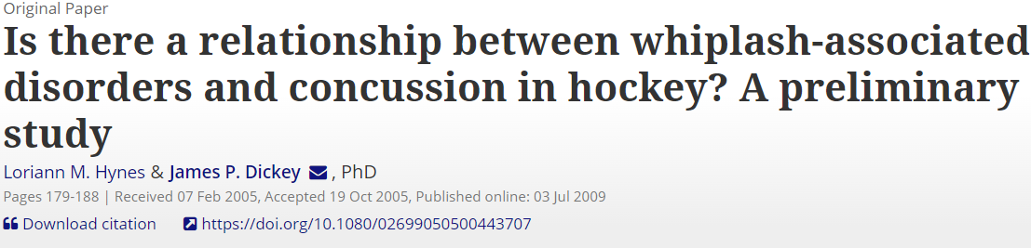
  Of 183 total players on twenty teams of various skill
    High school, College, Adult rec leagues
  13 suffered injury
  All 13 were evaluated and diagnosed with both whiplash and concussion by way of physical exam findings.
Notes:
Only study I am aware of that actually involved physical examination

Slide 68
How can we asses?

Slide 69
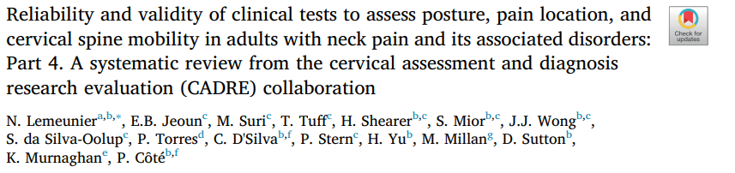

Slide 70
Screened 116 full text articles
found preliminary evidence of:
1) reliability of visual inspection, aided with devices (CROM and digital caliper) to assess head posture;
2) reliability and validity of soft tissue palpation to locate tender/trigger points in muscles;
3) reliability and validity of joint motion palpation to assess stiffness and pain provocation in combination;
4) range of motion tests using visual estimation (in cervical extension only) or devices (digital caliper, goniometer, inclinometer) to assess cervical mobility.

Slide 71
Symptom Comparison
Whiplash
Concussion
Neck Pain
Headaches
Shoulder Pain
Visual Disturbance
Vertigo
Tinnitus
Radicular Symptoms
Fatigue
Sleep Disruption
Concussion
Unsteadiness
Disc Herniation
Headache
Nausea
Vomiting
Balance problems
Dizziness
Visual Problems
Fatigue
Light sensitivity
Noise sensitivity
Numbness/ Tingling
Dazed or stunned
Feeling “foggy”
Feeling “slowed down”
Difficulty concentrating
Memory problems
Confusion about recent events
Answer questions slowly
Repeats questions
Drowsiness
Sleeping less than usual
Trouble falling asleep
Irritability
Sadness
More emotional
Nervousness
Murphy, D.R. (2000). Conservative Management of Cervical Spine Syndromes. New York: McGraw Hill
Almasi SJ, Wilson JJ. An Update on the Diagnosis and Management of Concussion. WMJ. 2012 111(1) 21-27

Slide 72
Notes:
Do concussion treatment guidlines recommend cervical spine treatment?
http://www.polleverywhere.com/multiple_choice_polls/4RZOjP100fs0HlnE13Iar

Slide 73
American Medical Society for Sports Medicine
“In the acute phase of a concussion manual therapy may be considered especially if there is concurrent neck pain”
Harmon KG et al. American Medical Society for Sports Medicine Position Statement: Concussion in Sport. Clinical Journal of Sports Medicine 2013; 23: 1-18
Notes:
An interesting recommendation.

Slide 74
6th International consensus statement on concussion in Sport
Referral to clinicians with specialized knowledge and skills in concussion management should be considered for the targeted treatment of persisting symptoms. This may include the management of cervicogenic symptoms, migraine and headache, cognitive and psychological difficulties, balance disturbances, vestibular signs and oculomotor manifestations.
Specialist clinicians should be used as part of a clinician network
  may vary depending on the region, practice culture and local healthcare environment, and available areas of competency and expertise.
This SRC clinician network may include sports medicine physicians, athletic trainers/therapists, physiotherapists, occupational therapists, sports chiropractors, neurologists, neurosurgeons, neuropsychologists, ophthalmologists, optometrists, physiatrists, psychologists and psychiatrists.
Notes:
An interesting recommendation.

Slide 75
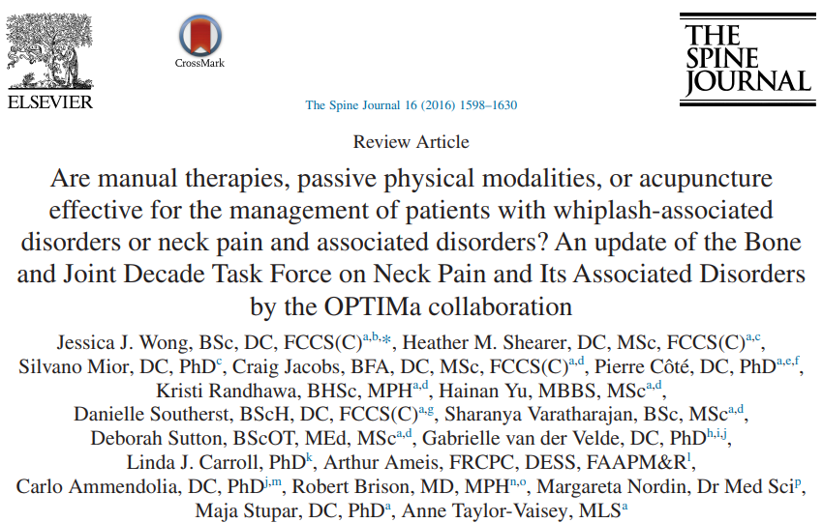

Slide 76
Our review adds new evidence to the Neck Pain Task Force and suggests that mobilization, manipulation, and clinical massage are effective interventions for the management of neck pain.
It also suggests that electroacupuncture, strain-counterstrain, relaxation massage
some passive physical modalities (heat, cold, diathermy, hydrotherapy, and ultrasound) are not effective and should not be used to manage neck pain.

Slide 77
Treatment for whiplash
Quebec Task Force guidelines recommend early intervention for whiplash that includes mobilization, manipulation, and exercise in combination with limited use of medications ₃₀.
These types of treatments have shown to be beneficial with whiplash injuries and neck pain ₃₄.

Slide 78
Does it work?

Slide 79
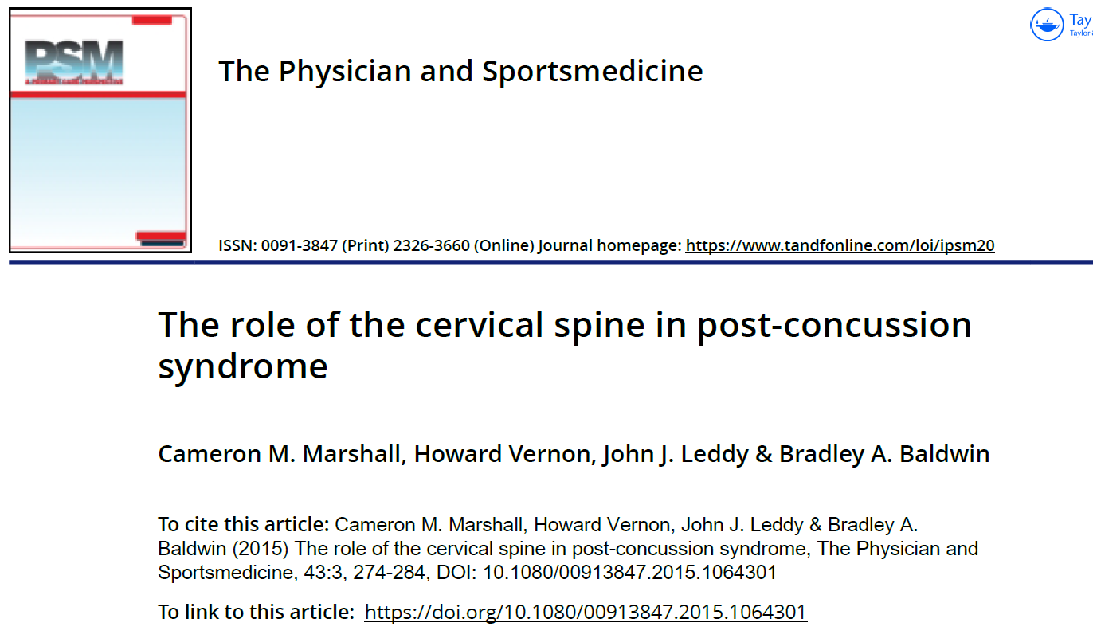

Slide 80
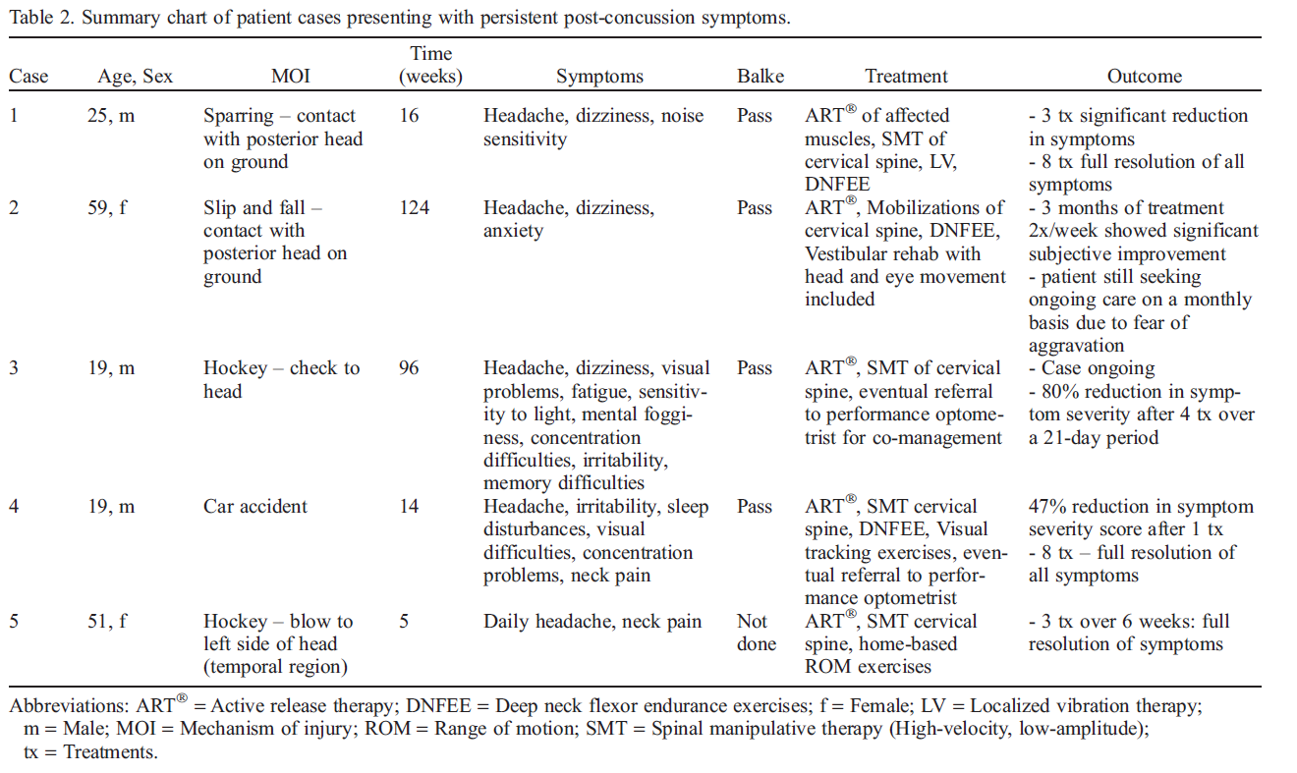

Slide 81
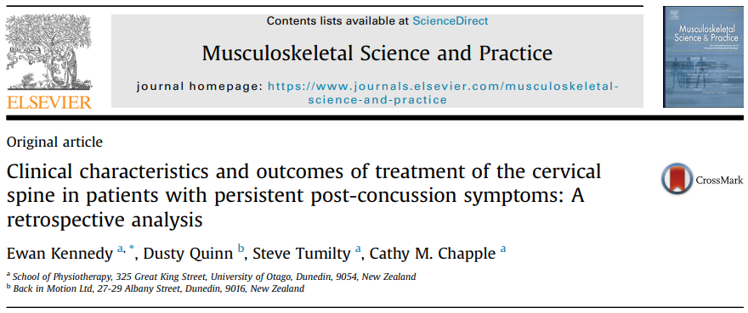

Slide 82
Study population
Referred from a specialised and multidisciplinary concussion service for the purpose of cervical spine assessment
Note that not all patients in this service are referred for cervical spine assessment, the decision to refer is based on an initial interview and triage by the multidisciplinary team.
46 referred patients identified
32 felt to have cervicogenic symptoms
14 referred to different clinic for treatment
1 not treated
1 did not return
21 treated and analyzed

Slide 83
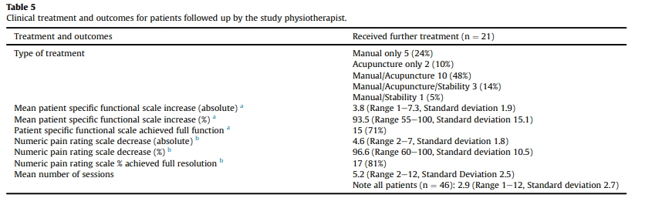

Slide 84
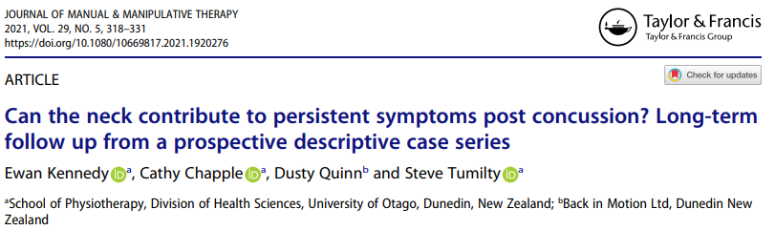

Slide 85
This is a long term follow up on 12 of the patients from the previous case series.

Slide 86
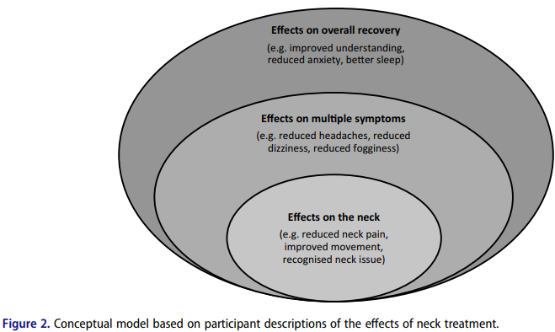

Slide 87
Patients with persistent neck pain, headaches and/or dizziness following a sports related concussion.
The control group (15) received “standard physiotherapy”
The experimental group (15) also received “manual therapy and cervicovestibular rehabilatation”
Within 8 weeks 73% of patients in the expirimental group had been returned to play in comparison to 7% of the control group
Schneider et al. Cervicovestibular rehabilitation in sport-related concussion: a randomised controlled trial. Br J Sports med 2014 1294-1298
Notes:
Also a few case series of patients receiving manual therapy/manipulation with improvement.

Slide 88
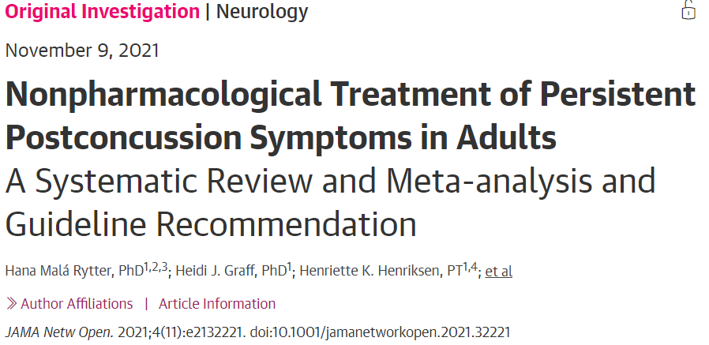
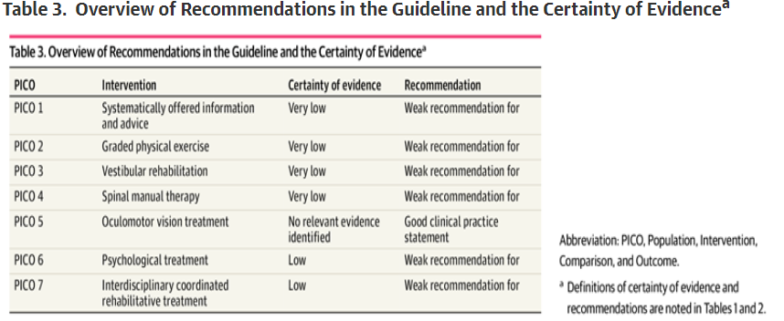

Slide 89
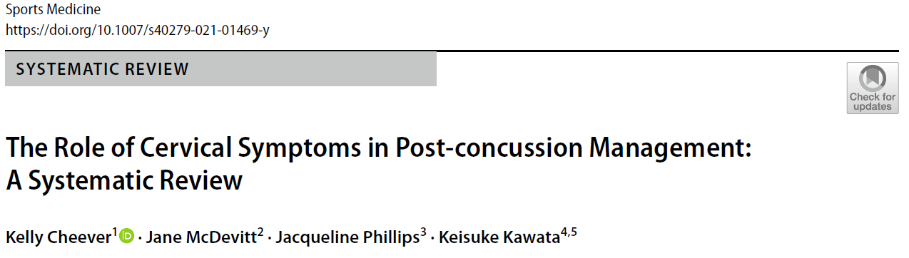

Slide 90
What should be done
Physical exam
  Rule out more serious cervical spine injury
    Step off deformity
    Alar ligament stress test
    Point tenderness
    Severe muscle guarding
  Cranial nerve examination
  Neuromotor examination
    Muscle stretch reflexes BUE and BLE
    Myotomes BUE and BLE
    Demratomes BUE and BLE
    Pathologic reflexes
  Patient reported outcome measures (PCSS)
  Buffalo Concussion treadmill test?

Slide 91
What should be done?
Physical exam continued
  ROM
  Assess stiffness
Treatment
  Manual therapy/manipulation
  Stretching
  Strengthening exercises

Slide 92
Notes:
How comfortable are you with the return to play process for concussions
http://www.polleverywhere.com/multiple_choice_polls/6ZvMFy3SOD7zEBUnce5yN

Slide 93

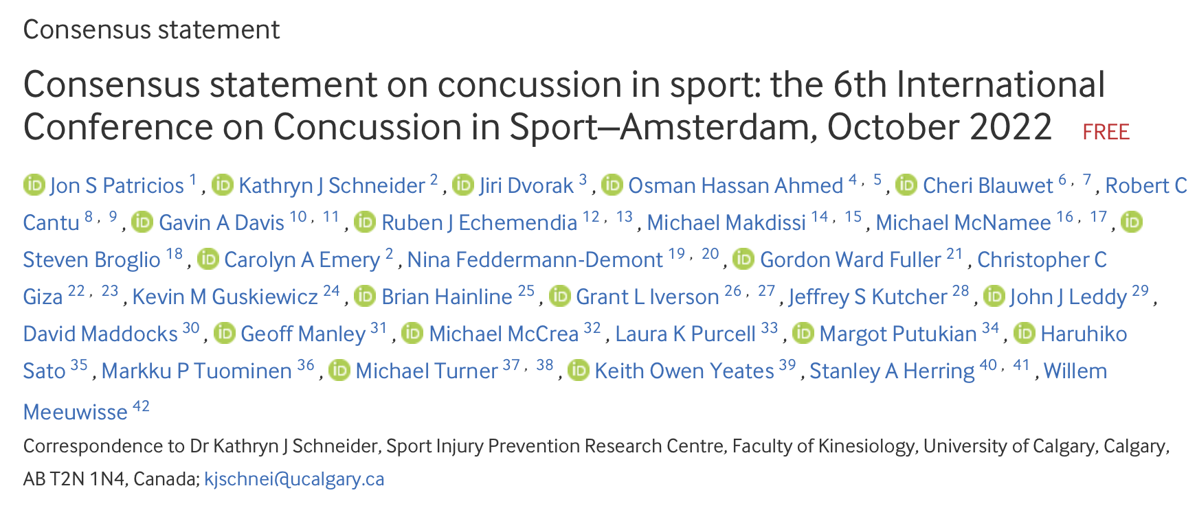

Slide 94
^{6th} international conference on concussion in sport (2022)
SRCs can result in diverse symptoms and problems and can be associated with concurrent injury to the cervical spine and peripheral vestibular system.
The literature has not evaluated early interventions, as most individuals recover in 10–14 days.
A variety of treatments may be required for ongoing or persistent symptoms and impairments following injury.
The data support interventions including psychological, cervical and vestibular rehabilitation.

Slide 95
11 Rs
Recognize
Reduce
Remove
Re-Evaluate
Rest and Exercise
Refer
Rehabilitation
Recovery
Return-To-Learn
Return-To-Sport
Reconsider
Retire
Refine
Notes:
TIME

Slide 96

Recognize

Slide 97

Reduce

Slide 98
Reduce: Prevention of Concussion
Policy/Rule Changes
  Disallowing body checking in child/adolescent hockey reduced concussion rated by 58%
  Restricting collision time in practice across all age groups in American football reduced practice related concussion by 64%
PPE
  Mouthguards associated with 28% reduction in concussion in ice hockey in all ages
Training strategies
  Neuromuscular training warm ups decreased concussion in Rugby across all age groups
Notes:
TIME

Slide 99

Remove

Slide 100
Remove: Sideline Evaluation
When: suspicion of a possible concussion to avoid further protentional injury
  Immediate removal with following signs/symptoms
    Actual/suspected LOC
    Seizure
    Tonic posturing
    Ataxia
    Poor balance
    Confusion
    Behavioral changes
    Amnesia
Notes:
TIME

Slide 101
Remove: Sideline Evaluation
Typical evaluation on sports sideline takes 10-15 minutes
Includes neuro exam and SCAT6
Sports leagues should allow the time for this to occur off-field and in a quite space.
Notes:
TIME

Slide 102

Re-evaluate

Slide 103
Re-evaluate
An athlete with SRC may be evaluated in the emergency room or doctor’s office as a point of first contact after injury or may have been referred from another care provider. In addition to the points outlined above, the key features of follow-up examination should encompass:
Immediate word recall 10-15 word list
Measurement of BP and heart rate in two positions.
Evaluation of cervical spine range of motion, muscle spasm, and palpation for segmental or midline tenderness.
Neurological exam (CN, spinal nerves, motor function, LTS, DTRs)
Timed tandom gait
VOM screen
Delayed word recall

Slide 104

Rest?

Slide 105
Relative rest including ADLs, reduced screen time indicated up to two first days after injury.
After 48 hours limited screen time not impactful
Individuals can return to light walking within first 48 hours

Slide 106

Exercise

Slide 107
Exercise
Systematically advance exercise based on degree of exacerbation with prior bout
HCPs can prescribe subsymptom threshold exercise in initial 2-10 days
  Doesn’t elicit more than a mild (2 point) increase in symptoms
  Short duration (less than 1 hour)
Continue to increase intensity/duration of activity as above
Stop progression if more than the above.

Slide 108
Refer

Slide 109
Refer
Referral to clinicians with specialized knowledge and skills in concussion management should be considered for the targeted treatment of persisting symptoms. This may include the management of cervicogenic symptoms, migraine and headache, cognitive and psychological difficulties, balance disturbances, vestibular signs and oculomotor manifestations.
Specialist clinicians should be used as part of a clinician network
  may vary depending on the region, practice culture and local healthcare environment, and available areas of competency and expertise.
This SRC clinician network may include sports medicine physicians, athletic trainers/therapists, physiotherapists, occupational therapists, sports chiropractors, neurologists, neurosurgeons, neuropsychologists, ophthalmologists, optometrists, physiatrists, psychologists and psychiatrists.

Slide 110
Persistent Symptoms
(> 4 weeks in all age groups)

Slide 111
Rehabilitation

Slide 112
Rehabilitation
If dizziness, neck pain and/or headaches persist for more than 10 days, cervicovestibular rehabilitation is recommended.
If symptoms persist beyond 4weeks in children and adolescents, active rehabilitation and collaborative care may be of benefit. For children, adolescents and adults with dizziness/balance problems, either vestibular rehabilitation or cervicovestibular rehabilitation may be of benefit.
Rehabilitation may be targeted to individual symptoms or maybe more general and focus on overall recovery. The effects of combinations of rehabilitation, optimal timing for initiation of rehabilitation and modifying factors (such as age and sex) are not yet well established and require further evaluation.
Notes:
In addition to subsymptom threshold acitivty outlined earlier.

Slide 113
Recovery

Slide 114
Recovery
Assessment of symptom reports (including concussion- related symptom resolution at rest, with cognitive activities and following physical exertion).
Other outcomes relevant to ongoing symptoms (eg, response to physical exertion, post- traumatic headaches, standing balance, dynamic balance, vestibuloocular reflex (VOR) function, oculomotor (OM) function, symptom reproduction with VOR and OM testing (eg, VOMS), cognition, dual tasking).
Measures of return to activity such as Return-To-Learn and Return-To-Sport (Next).
Notes:
No agreed upon definition

Slide 115


Return to learn

Slide 116
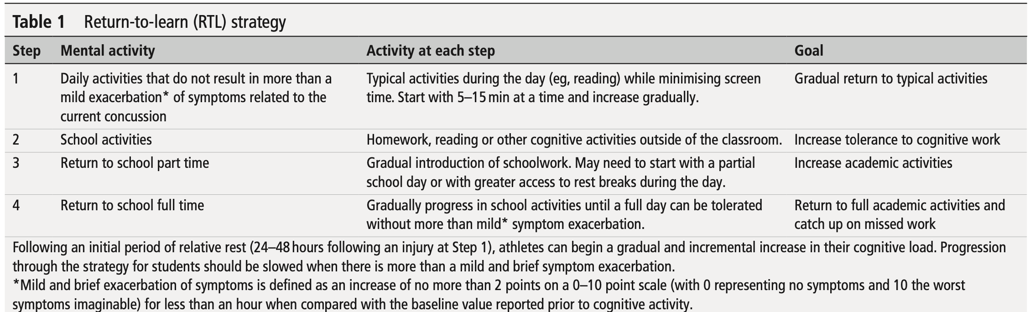
Graduated return to sport
The process of recovery and then return to sport participation after an SRC follows a graduated stepwise rehabilitation strategy.
After a brief period of initial rest (24–48hours), symptom-limited activity can be begun while staying below a cognitive and physical exacerbation threshold (stage 1).
Once concussion-related symptoms have resolved, the athlete should continue to proceed to the next level if he/she meets all the criteria (eg, activity, heart rate, duration of exercise, etc) without a recurrence of concussion-related symptoms.
Generally, each step should take 24hours, so that athletes would take a minimum of 1 week to proceed through the full rehabilitation protocol once they are asymptomatic at rest.
However, the time frame for RTS may vary with player age, history, level of sport, etc, and management must be individualized.

Slide 117

Return to sport

Slide 118
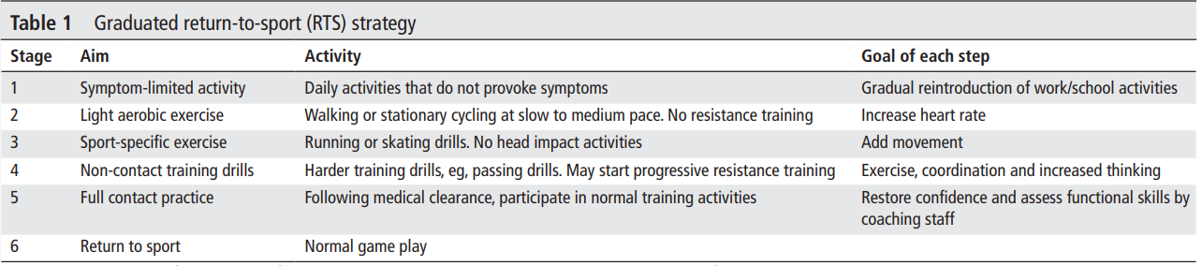
Graduated return to sport
The process of recovery and then return to sport participation after an SRC follows a graduated stepwise rehabilitation strategy.
After a brief period of initial rest (24–48hours), symptom-limited activity can be begun while staying below a cognitive and physical exacerbation threshold (stage 1).
Once concussion-related symptoms have resolved, the athlete should continue to proceed to the next level if he/she meets all the criteria (eg, activity, heart rate, duration of exercise, etc) without a recurrence of concussion-related symptoms.
Generally, each step should take 24hours, so that athletes would take a minimum of 1 week to proceed through the full rehabilitation protocol once they are asymptomatic at rest.
However, the time frame for RTS may vary with player age, history, level of sport, etc, and management must be individualized.

Slide 119
Reconsider: Potential Long-Term Effects

Slide 120
Retire

Slide 121

What’s the big deal?

Slide 122
Second Impact Syndrome
Highly debated
Proposed brainstem herniation following second trauma when still recovering from a first
  Cerebral vascular congestion causes cerebral edema
  Disrupts cerebral autoregulation
    Results in massive brain swelling
Some argue that some people are predisposed to cerebral edema following the initial trauma and the second trauma is not the cause

Slide 123
Second Impact Syndrome
A patient recovering from a concussion is more susceptible to sustaining another concussion in the initial 7-10 days₃
We do not know how to identifiy this proposed at risk population so in my mind this is a mute point

Slide 124
Second Impact Syndrome
Patients aged 12-18 appear to be at a higher risk for catastrophic injury₃₇
  Children have a lower autoregulation of bloodflow₃₇

Slide 125
Second Impact Syndrome
Reported to be responsible for 30-40 deaths in the past decade ₅₉

Slide 126
Second Impact Syndrome
Opinion Statement:
Until we can define and understand the mechanism of Second Impact Syndrome every patient should be treated as though they are at risk for this potentially devastating situation

Slide 127
Second Impact Syndrome Case Report

Slide 128
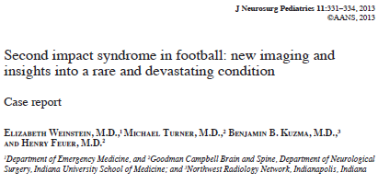

Slide 129
17 year old male: Helmet to helmet hit on punt return
  “I feel dizzy, I can’t really see straight”
Played remaining 15 minutes with no apparent difficulty
Was not reported to coach/training staff until after the game
Reported headache attributed to hit
  “Hardest hit of his life”
Resumed regular activity next 3 days
  Faituge
  Persistent headache
    Exacerbate by lateral upward gaze

Slide 130
Day 4
  following game asked to see doctor due to severe headache
    Eval and neurological exam normal
    Coordination and balange good
    Fundoscopic exam grossly normal
    Mental status exam normal
  Unenhanced CT reported normal at initial reading and by several neuroradiologists and neurosurgeons following
  Doctor advised patient refrain from practice until symptoms resolved
  Patient returned to practice that day

Slide 131
Day 5
  Patient complained of persistent headache/apparent difficulty with concentration
  Full dress practice slow to get up following fourth hitting drill
    Reported being “OK” to teammate but had headache
  Several plays later dropped to his knees
    Dizziness
    Headache
    Could not feel legs
  Became unresponsive
  General seizure activity

Slide 132
Day 5 Continued
  Taken to ER intubated and CT showed thin bilateral subdural hematoma
    Treated with medication
    Aeromedical transport to Indiana University school of medicine

Slide 133
Indiana University School of Medicine
BP: 143/79
HR: 93
Glasgow Coma scale 7T (intubation)
  Eye open to noxious stimulus
  Bilateral withdrawl upper extremities
  Mixed leg posturing
  Pupils 3mm and sluggish
Grade 3+ reflexes through out
Bilateral clonus
Absent babinski reflex
Non-contrast CT
  Subdural dematomas bilateral
  Mild cerebral swelling
Coagulation, chemistry panel, urine toxicology all normal
Intracranial Pressure (ICP) 25-30mm Hg
  Normal ICP 5-15 mm Hg

Slide 134
MRI of brain and C/S
  Mild downward transtentorial herniation
  Bilateral subdural hematomas
  Restricted diffusion in medial left thalamus
  Caudal displacement of the midline structures, thalamus and hypothalamus
NO EVIDENCE OF
  Upper cervical spinal cord injury
  White matter shear injury
  Cerebral edema

Slide 135
Treatment
  Sedation with medication
  Pentobarbital coma
  ICP remained elevated
3rd day of hospital stay CT showed stable subdural hematomas
    4mm left subfalcine shift
    Effacement frontal/occipital horns
Subsequent imaging
  Resolution of hematoma
  Encephalomalacia
    Both thalami
    Medial frontal lobes
    Corpus Collosum

Slide 136
Complications
  Hypotension
  Metabolic acidosis
  Renal failure w/empyema
    Required thoracotomy
  Cardiac arrest
Discharged to rehabilitation hospital day 54
Discharged home day 98
At time of discharge the patient was nonverbal and nonambulatory

Slide 137
More than three years after injury patient living at home
  Limited
    Verbal skills
    Motor skills
    Cognitive skills

Slide 138
What can we learn from this catastrophe?
A Normal CT scan is not clearance to return to play!
Second Impact Syndrome can be devastating
Any patient still experiencing symptoms should not return to normal activity
This is the responsibility of all health care providers and coaches

Slide 139
Second Impact Syndrome Case Report #2 with implications for the Chiropractor
Notes:
Player checks self our of game collapses. Multiple surgeries. Family sues school, Ats, health system, chiropractor. Health system settles. Sues DC

Slide 140
Prevalence of
Neck Pain and Disability
in Concussion
Notes:
I want to Thank you for hanging in here and I also want to thank the section for this opportunity!

Slide 141
Purpose
Explore the prevalence of comorbid neck pain and disability in patients following concussion
Assess the clinical characteristics of the associated symptoms of neck pain and headache

Slide 142
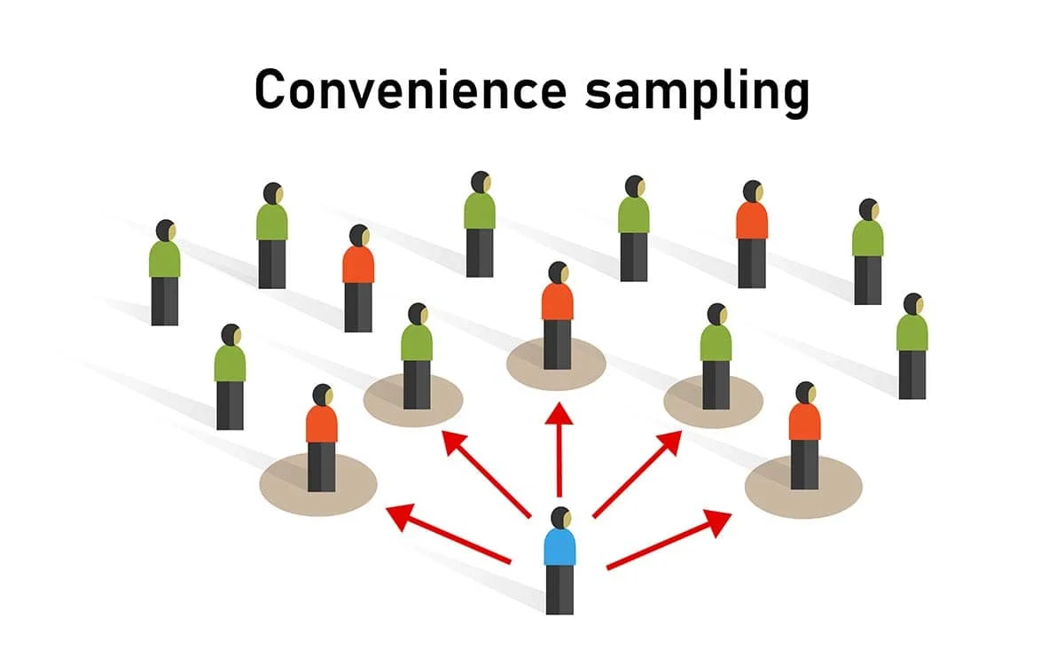
METHODS
Cross-sectional survey
Inclusion Criteria:
Adults with a history of concussion
Glasgow Coma Scale: 13-15
Concussion clinics:
  University of Pittsburgh Medical Center
  Medical College of Wisconsin
Exclusion Criteria:
Age < 18 years

Slide 143

Methods
Demographic Questions:
  Sex
  Age
  Duration since injury
  Cause and Mechanism of injury
Presence of headache
  Characteristics
Presence of neck pain
  Location
  Numeric pain rating
  Neck Disability Index ¹⁶

Slide 144
Statistical Analysis
​
Proportion of respondents with comorbid neck pain
Baseline Characteristics
    Descriptive Statistics
Comparisons between patients with and without neck pain
    Chi-square tests (α=0.05)
Association between HA characteristics and neck pain
    Odds ratios (95% CI)
Notes:
We estimated the proportion of individuals with comorbid neck pain and corresponding 95% confidence interval
Analyses were then stratified by the presence/absence of neck pain.
Categorical data were reported as frequencies and percentages and continuous data were reported with means and standard deviations
Categorical variables for those reporting neck pain were compared to those without neck pain using Chi-square tests (α=0.05)
We also calculated odds ratios and 95% confidence intervals as measures of association between headache characteristics and presence of neck pain.

Slide 145
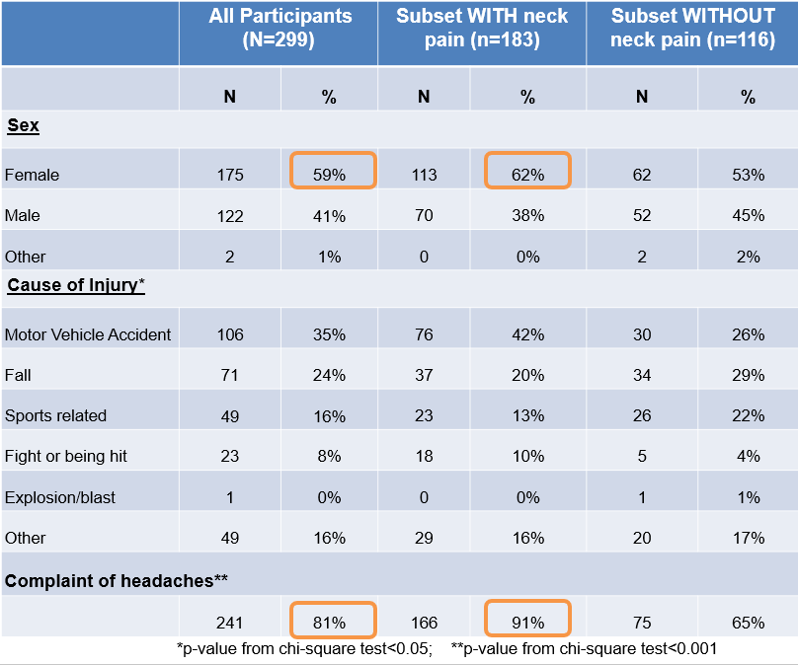
Results
1,426 eligible patients
  299 adult patients completed the survey
  Response rate of 21%
61% reported neck pain
Average age: 39 years
175 females (59%)
  62% reported neck pain
81% of all patients had complaint of headache
  91% of subset with neck pain

Slide 146
Results
 | Subset WITH neck pain (n=183)
 | N | %
Location of Neck Pain (more than one response was allowed)
Upper cervical (Co-1-2) | 124 | 68%
Lower cervical (C5-6-7) | 74 | 40%
Mid cervical (C3-4-5) | 62 | 34%
 | Mean | Std Dev
NDI Score (range 0-100) | 38 | 18
NPRS (range 0-10, average neck pain over past week) | 5.0 | 2

Slide 147
Results
Headache Only
Headache and Neck Pain
Neck Pain Only
Neither Headache Nor Neck Pain
N=17
(6%)
N=166
(56%)
N=75
(25%)
N=41
(13%)

Slide 148
Results
The subset of people who reported having headaches with neck pain when compared to those without neck pain had:
11.6 times higher odds of their headache getting worse with pushing their neck
(OR 11.62, CI 2.73-49.55)
3.7 times higher odds of their headache getting worse with movements of the head and neck (OR 3.71, CI 1.99-6.90)
4.6 times higher odds of their headache radiating forward (OR 4.58, CI 2.39-8.77)
These are consistent with cervicogenic headache

Slide 149
Limitations
Possible response bias
Moderate response rate (21%)
Reasons for declining to complete survey not recorded
No cervical spine examination
Survey questions not validated
No questions to exclude possibility of prior chronic neck pain history
Convenience sample with no a priori sample size calculation
​

Slide 150
Key Take Aways
High prevalence of comorbid neck pain in our sample of concussion patients (62%)
Moderate levels of neck pain (NPRS: 5/10) and disability (ODI: 38/100)
Most common location of neck pain = upper cervical region
Neck pain patients report characteristics of cervicogenic headache
​

