Slide 1
Artificial Intelligence:
Current State & Future Perspectives
Adarsh Ramesh
Oct 2024

Slide 2
Topics
Evolution of technology
What is Artificial Intelligence?
Why now?
Types of AI
Supervised Learning
Unsupervised learning
AI in healthcare
AI in other industries
Generative AI
Responsible AI
Future Perspectives

Slide 3
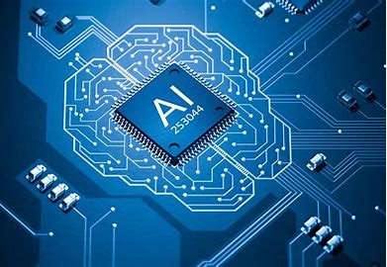
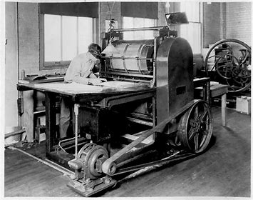
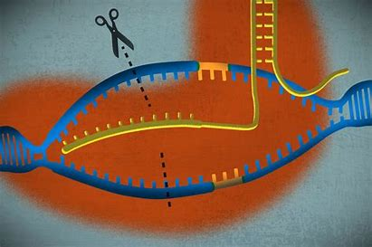








Brief History of Technology
AI
Progress in technology is exponential
CRISPR
Internet
Computer
Electric light
Telephone
Printing
Gun Powder
Irrigation
Fire
1 Million years
10k years
2k years
100 years
35 years

Slide 4
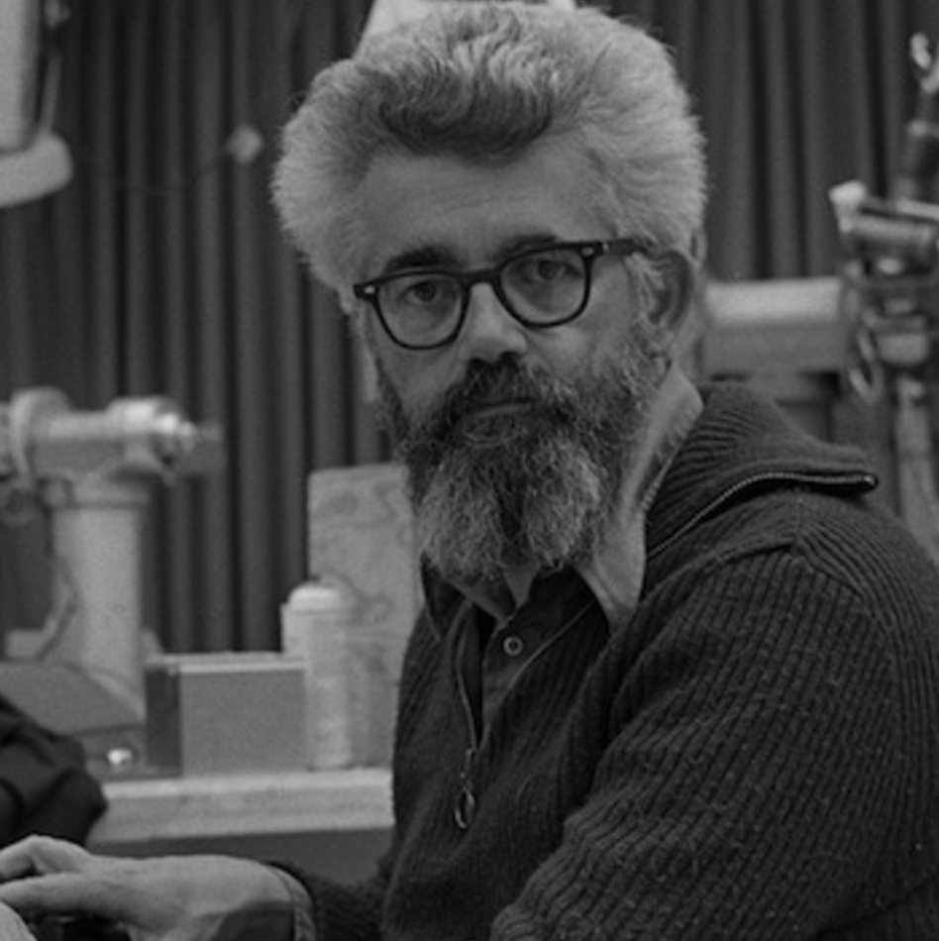
What is Artificial Intelligence
Artificial Intelligence (AI), a term coined by emeritus Stanford Professor John McCarthy in 1955, was defined by him as “the science and engineering of making intelligent machines”. Much research has humans program machines to behave in a clever way, like playing chess, but, today, we emphasize machines that can learn, at least somewhat like human beings do.
Artificial intelligence (AI), in its broadest sense, is intelligence exhibited by machines, particularly computer systems. It is a field of research in computer science that develops and studies methods and software that enable machines to perceive their environment and use learning and intelligence to take actions that maximize their chances of achieving defined goals.^{[1]} Such machines may be called AIs.

Slide 5
Why AI Now?
Progression of key AI related technologies
1’st paper on Neural Networks
1’st Artificial Neural Network
Random Forest Algorithm invented
Map Reduce Architecture
LLM
1943
1958
1995
2004
2022
Theoretical Concept
Technical Concept
Industrial grade algorithm
Large Scale Distributed Computing
Scalable Technology for ‘human-like’ content generation

Slide 6
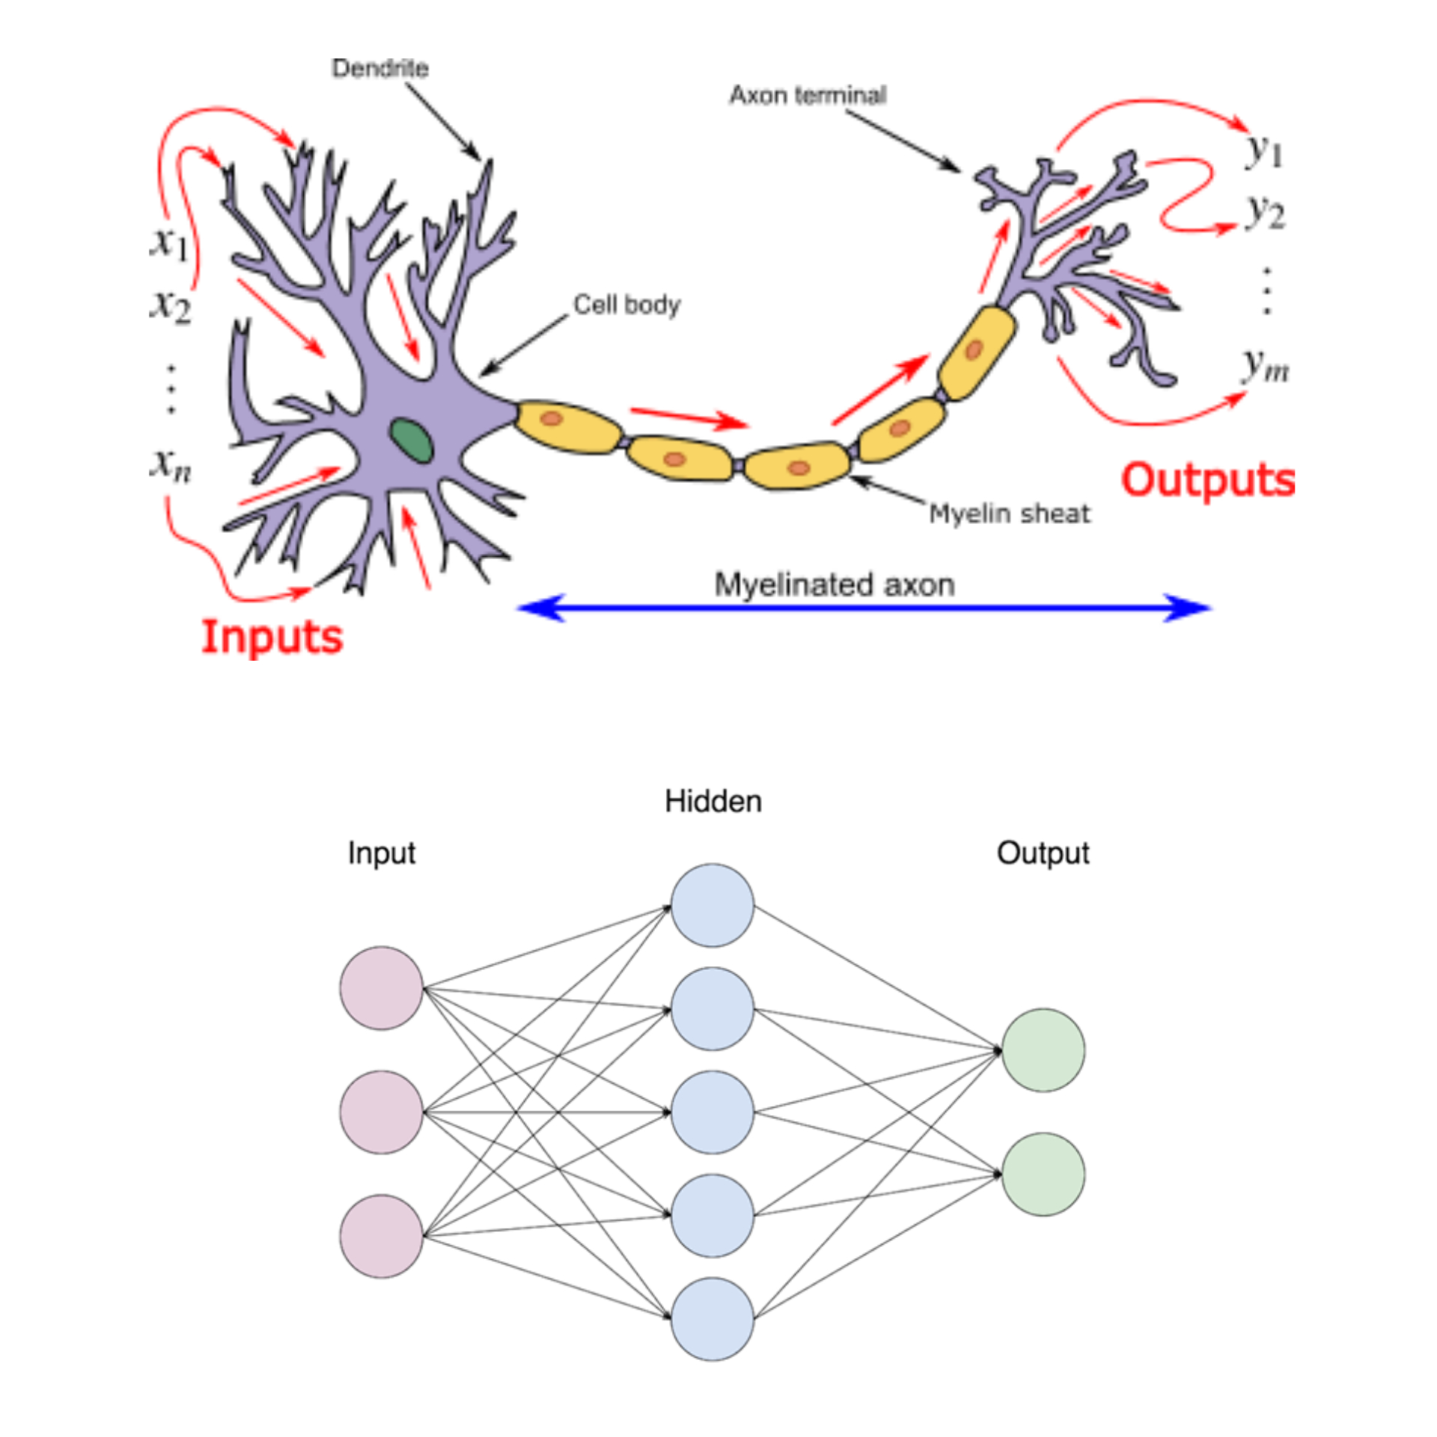
Artificial Neural Networks
Sunny/Rain
Play Tennis
Humid/Dry
Don’t Play Tennis
Weekday/Weekend

Slide 7
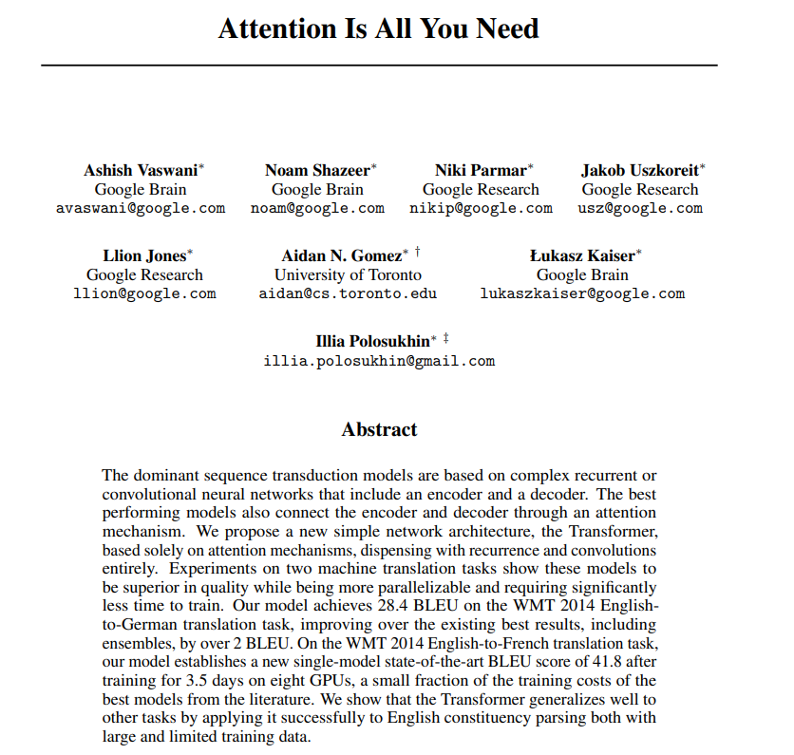
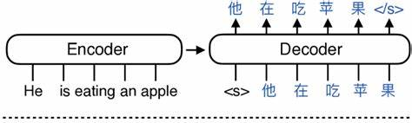
“Attention is all you need” paper
Encoder Decoder language translation model
There is a relatively differential importance to each word in the sentence to inform the meaning requiring different ‘attention’.
“It took almost 24 minutes of play time for Minnesota Vikings to score a touchdown”

Slide 8
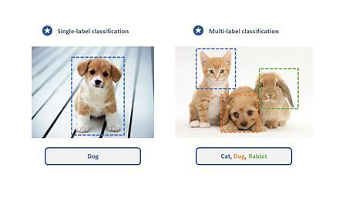
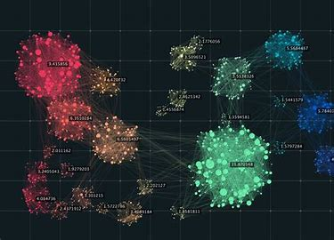
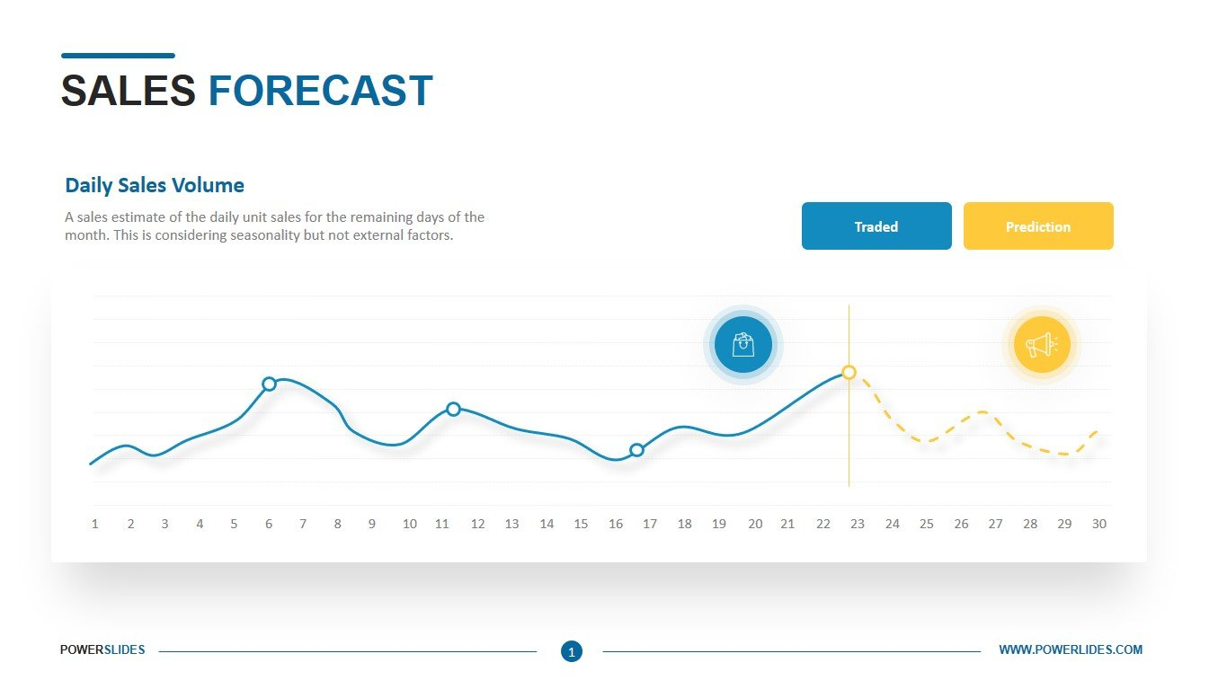



Types of AI Algorithms
Supervised Learning
Unsupervised Learning
Majority of AI application use Supervise learning.
Requires historical “ground truth”
Used when “ground truth” data is not available
Approach used to mine common patterns

Slide 9
Types of Supervised learning
Classification
Which category?
Regression
How much?

Slide 10
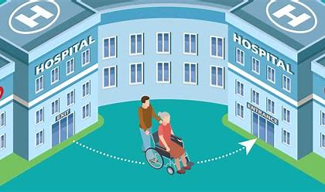


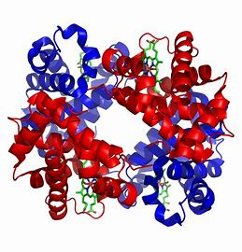
AI in healthcare
Medical event predication (Readmission, elective surgeries, etc.)
Fraud detection
Cost trend predictions (for underwriting)
Prior Auth automation
Claims processing automation
Protein structure predictions

Slide 11
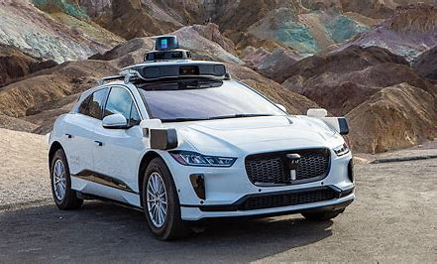



AI in other industries
Autonomous vehicles
Search Engines
Content Personalization
Security

Slide 12
Generative AI
What is Generative AI?
  Type of AI that generates new content such as text, audio, video, etc. based on user’s request. E.g., Chat GPT, Dall-E, Bard, Stable Diffusion, etc.
How does it work?
  Gen AI model are trained on vast amounts of data using neural network architectures to predict words/phrases in the data-set. E.g.:
  As a health administrator, we’ll show you how leveraging physical medicine can transform health care and help you lower costs, achieve better outcomes, increase patient satisfaction and improve the work life of providers.
Once trained these models are then available to ‘generate’ content based on the ‘learnt’ knowledge and input context
Why is it so transformative?
  Automation of routine tasks
  Information search
  Decision making

Slide 13
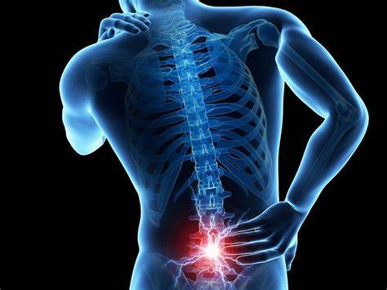
AI in Spine Care
Need
Management of Spinal disorders has very High variability in care (surgical and non-surgical)
This leads to sub-optimal care, poor outcomes and wasted costs
Applications
Predicting glide path to Spine Surgery for more cost-effective care recommendations
Standardized treatment approach for specific case types
Personalized Physical recommendations based on individual history

Slide 14

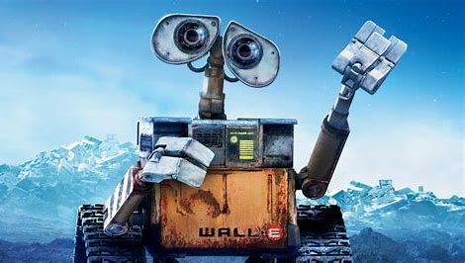
Responsible AI
Ensuring AI Systems are developed and used in an ethical and lawful manner avoiding harm to the society
Guiding Principals for Ethics in AI:
Fairness – Analyzing & taking actions to mitigate bias & impacts to select groups
Privacy – Protect information privacy and comply with laws regarding data collection, processing & storage
Transparency - Provide reasonable explainability on AI systems decision making
Reliability – Operate safely & effectively under boundary conditions

Slide 15
AI Regulations
Key Elements:
Regulates the use of Personal Data
Data usage must be lawful, fair and transparent
Data must be collected for specific & legitimate purpose
Minimum necessary data must be collected
Collected data must be accurate & upto date
Personal data must be processed in a secure manner
Must provide access to data upon request
Data Controllers must be responsible to demonstrate compliance to above princip
EU GDPR – General Data Protection Regulation
US – Combination of Federal & State regulations
Algorithmic Accountability Act (not yet passed)
California Consumer Privacy Act
  Key Considerations
  Appointing AI Compliance Officer
  Regular AI Audits
  AI guidelines & ethics education to all associates
  Monitor and update AI Policies

Slide 16
Future Perspectives on AI
Predictions
Content Generation
Decision Making
Available
Available
Evolving

Slide 17
Questions?

